Slide 1
Built Environment and Traffic Safety
Louis A. Merlin, PhD
Assistant Professor
School of Urban and Regional Planning
Florida Atlantic University

Slide 2
Overall Research Question
What is the influence of the built environment on traffic safety?

Slide 3
Current Research Efforts
Literature review of the built environment and safety
Analysis of residential accessibility on traffic safety

Slide 4
Literature Review on Traffic Safety
Scope:
Reviewed macroscopic studies of traffic safety in the literature
Studies of traffic safety at an areal unit – traffic analysis zone, census tract, or census block group
Reviewed the range of built environment measures considered for their impacts on traffic safety
Focus especially on built environment’s effect on crash risk

Slide 5
Risk vs. Exposure
Traffic Injury = Exposure x Risk x Injury Probability
Therefore, we can only assess the effect of the built environment on risk if we accurate assess the effect of the built environment on exposure first
Unfortunately, we often have poor measures of exposure, especially for bicyclists and pedestrians

Slide 6
Built Environment: Likely Exposure Variables
Population Density (+)
Employment Density (+)
Schools (+)
Sprawl (+)

Slide 7
Built Environment: Likely Risk Variables
Speed (+)
Number of Lanes (+)
Sidewalks (-)
Traffic Signals (-)
Bicycle Paths (-)
Safety in Numbers (-)

Slide 8
Built Environment: Ambiguous Variables – Could be Risk or Exposure
Number of Intersections (+/-)
Mixed Use (+)
Commercial Land Use (+)
Bus Stops (+)
Disadvantaged demographic segments (+/-)

Slide 9
Recommendations for Future Research
Explicitly categorize variables at exposure or risk a priori
Select the most appropriate exposure variable available
Select variables that are as close to the causal action of interest as possible, i.e. if speed is of interest, measure speed
Do not over-include variables just because they are available – this can confuse the direction of key relationships
Hold critical aspects of the built environment constant, i.e. examining school environments

Slide 10
Analysis of Residential Accessibility as a Factor in Crash Risk
The built environment is known to be associated with travel behavior
Accessibility has a strong relationship with vehicle miles traveled than other built environment measures
Therefore people who live in high accessibility environments may have lower exposure and therefore lower crash rates

Slide 11
Sprawl and Crash Rates
Most of the built environment – VMT – crash rate analysis to date has been conducted for county-level measures of sprawl
Sprawling counties have higher crash fatalities, but urban counties have higher rates of injury crashes
Spill-over problem – where someone lives is not necessarily where they crash
Address spill-over problem by identifying residential location of crash victims

Slide 12
Data and Method
Link all crashes for Charlotte-Mecklenberg county for 2013 to crash victim’s residential location
Predict crash rates as a function of accessibility, density at the residential location as well as demographic controls

Slide 13
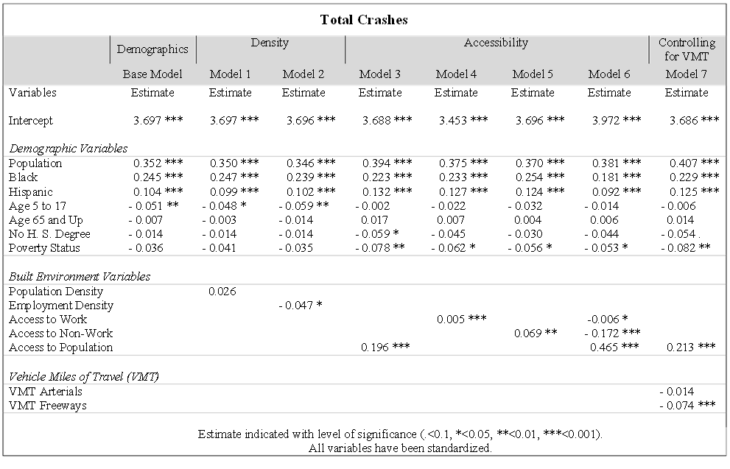
Results

Slide 14
Results

Slide 15
Findings
Contrary to expectations, accessibility appears to be positively correlated with crash rates, after controlling for population and demographic factors
Although people who live in high-accessibility areas may drive less, they may be exposed to other people’s driving more

Slide 16
Limitations
Spill-over with people living in Charlotte and crashing elsewhere. Spatial autocorrelation methods should partially address this problem
Crash data was for surface streets only. Possible that people in low accessibility areas are crashing more frequently on highways

Slide 17
Questions and Comments?
lmerlin@fau.edu

