Slide 1
Safe Systems and Urban Development
FAU Double Header!
Eric Dumbaugh: A Model for Safe Systems in Urban Environments
Louis Merlin: The Built Environment and Traffic Safety

Slide 2

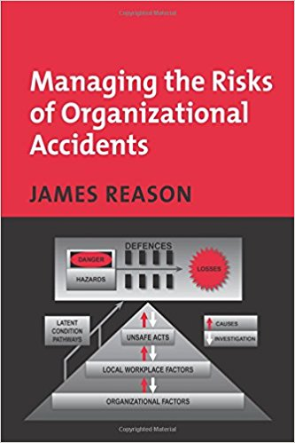
Towards Safe Systems in the United States
Industrial Systems, Behavioral Economics, and Social Psychology

Slide 3
Outline
Counterfactual Reasoning Contemporary Approach to Crash Analysis
The Limits of Counterfactual Reasoning The Case of Raquel and A.J. Nelson
A Broader Perspective Lessons from Urban Roadside Safety
Conclusion: A Model for Safe Systems

Slide 4
Counterfactual Reasoning
Part 1:

Slide 5
Psychological Processes:
Counterfactual Reasoning: A form of logic that falsifies antecedents to determine whether they negate consequences.
Form:
Antecedent → Consequence

Slide 6
Constructing Counterfactual Content
Outcome Closeness: We focus on antecedents that are immediately proximate to consequences.
Outcome Normality: Exceptional outcomes are presumed to follow from exceptional antecedents. We construct counterfactuals that shift the exceptional antecedent to its “normal” value.
Extant Norms: Counterfactual content is based on social norms of expected behavior (which are modifiable and socially constructed).
Source: Roese, 1997
Notes:
Individuals construct counterfactuals based on whichever antecedent was exceptional
- example: Kahneman

Slide 7
Current Safety Approach
Engineering Defenses
Individual
Errors and Violations
Crashes

Slide 8
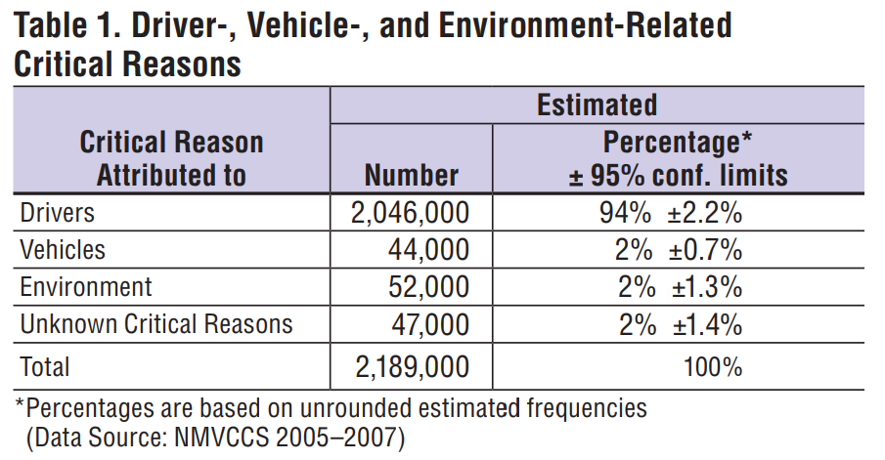
Counterfactual Reasoning: Critical Factors
Source: NHTSA, 2015

Slide 9
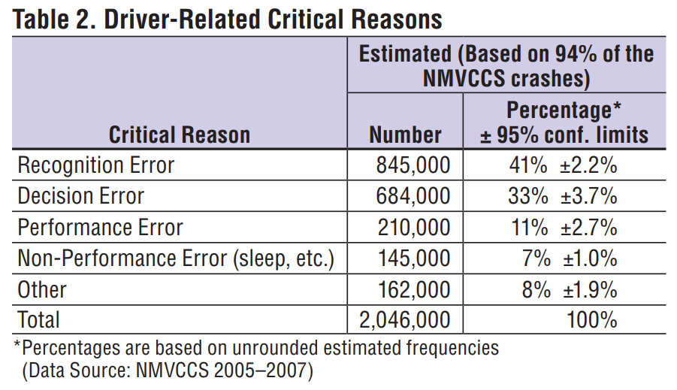
Counterfactual Reasoning: Driver Error
Source: NHTSA, 2015
Notes:
Recognition error, which included driver’s inattention, internal and external distractions, and inadequate surveillance, was the most (41% ±2.2%) frequently
assigned critical reason.
Decision error such as driving too fast for conditions, too fast for the curve, false assumption of others’ actions, illegal maneuver and misjudgment of gap or others’ speed accounted for about 33 percent (±3.7%) of the crashes.
performance error such as overcompensation, poor directional control, etc. Sleep was the most common critical reason among non-performance errors that accounted for 7 percent (±1.0%) of the crashes.
Other driver errors were recorded as critical reasons for about 8 percent (±1.9%) of the drivers.

Slide 10


Slide 11


Slide 12
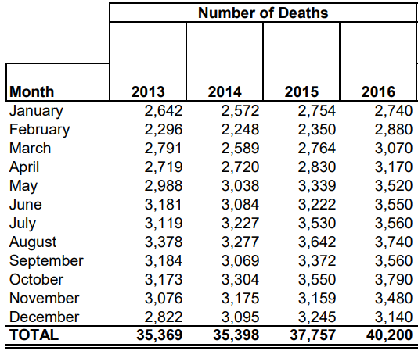
Traffic Fatalities in the US
Source: NHTSA, 2017
Notes:
6% increase

Slide 13
Blame the Victim
“It’s still the same things that are killing drivers — belts, booze, and speed.”
  Jonathan Adkins, Executive Director of the Governors Highway Safety Association
Source: New York Times, 2/15/2017

Slide 14
The Case of Raquel and A.J Nelson
Part 2:
“Blaming individuals is more emotionally satisfying than targeting institutions.”
- James Reason

Slide 15
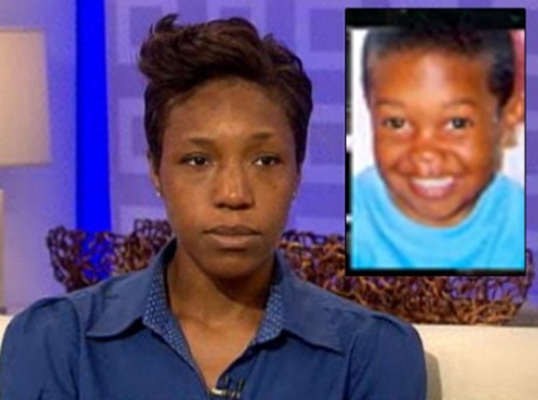
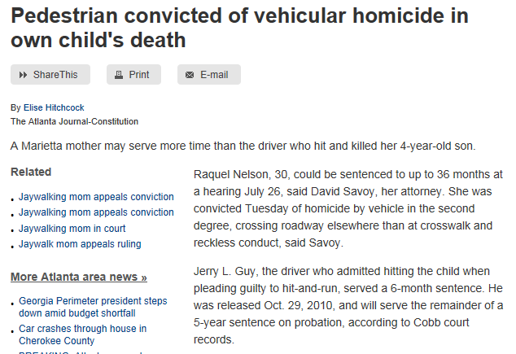
The Limits of Counterfactual Reasoning:
The Case of Raquel and A.J. Nelson

Slide 16
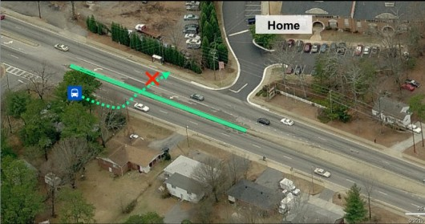
Engineering Defenses
Organizational
Environmental
Individual
Management Decisions and Organizational Processes
Error-Producing Conditions
Errors and Violations
Crashes
Notes:
Environmental – the location of a bus stop adjacent to a housing complex, in the absence of a crosswalk, creates conditions that encourage errors and violations.
Organizational – Policies on bus stop placement and the location of protected crosswalks lead to the creation of environments that encourage erros and violations

Slide 17
Active Failure: Actions taken by people with direct responsibility for the system, who may make slips, lapses, or mistakes.
Latent Failure: Policy decisions that result in dormant conditions that, when combined with active triggers, lead to crashes.
Notes:
The bus stop policy was not adopted to kill people, but to make transit more accessible. But it created a latent condition that, when activated by Raquel Nelson’s decision, resulted in the death of A.J Nelson.
Slips: Actions not carrier out as intended or planned, e.g., misreading road signs and exiting a roundabout on the wrong road
Lapses: missed actions or omissions, e.g., failing to do something due to lapses of memory or attention (not treating a powerless light as a four-way stop).
Mistakes: Wrong actions carrier out due to a faulty plan or action, e.g., someone believing something to be correct when it was, in fact, wrong.
Violations: Deliberate illegal actions, i.e., somebody doing something knowing it to be against the rules.

Slide 18
Active Failure Pathway
Engineering Defenses
Organizational
Environmental
Individual
Management Decisions and Organizational Processes
Error-Producing Conditions
Errors and Violations
Crashes
Latent Error Pathway
Notes:
Latent error pathway: policies applies without knowledge of later consequences.

Slide 19
Urban Roadside Safety
Part 3: Illustration

Slide 20
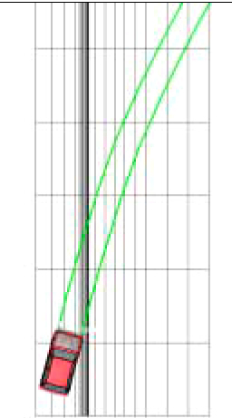
Illustration: Urban Roadside Safety
Presumption is that run-off-roadway events are random and unpreventable.
If so, then rates of run-off-roadway events should be relatively constant.
Studies of two-lane, rural roads support this conclusion…
Presumed Roadside Encroachment Pattern

Slide 21
Theoretical Precepts:
Engineering Defenses
Drivers will err, make mistakes, and engage in behaviors that result in crashes and injuries.
Driver errors are random and unpreventable.
The best strategy for addressing driver errors is to ensure that all roadways are “forgiving” to such errors when they occur.
Individual
Errors and Violations
Crashes

Slide 22
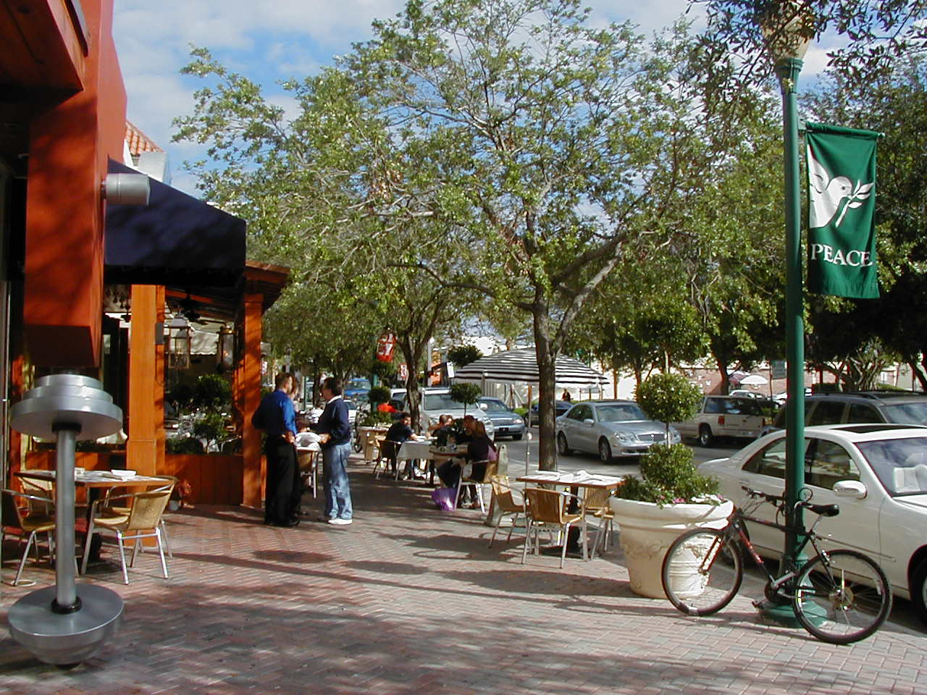
Research Question: Is This Unsafe?

Slide 23
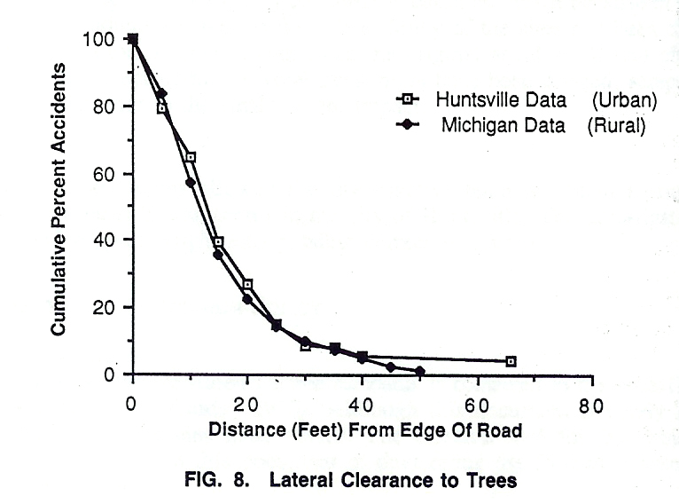
Basis for Urban Clear Zone Policy
The Evidence:
The majority of urban tree-related crashes occur less than 30 ft from the travel-lane
Study Conclusion: 30 ft clear zones in urban areas are desirable for safety.
Source: Turner and Mansfield, 1990

Slide 24
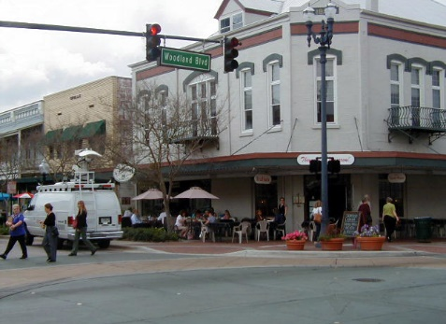
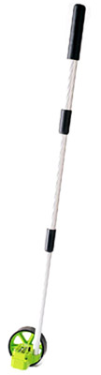
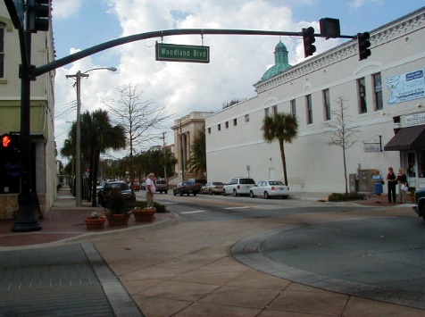
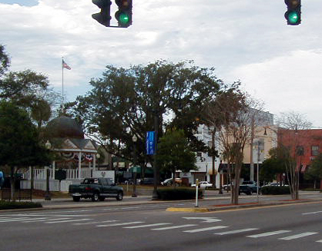
Crash Site Investigation: 27 Miles of Urban Arterials in Central Florida
SR 15, DeLand (Woodland Blvd)
SR 44, DeLand (New York Ave)
SR 40, Ocala (Silver Springs Blvd)
Notes:
Total – 27.25 Miles of roadway

Slide 25
Revisiting Turner and Mansfield Findings

Slide 26
Crash Probability Mirrors Setback Distribution
Notes:
Lateral offset doesn’t matter. Regardless of fixed-object setback, the probability of crash is the same.

Slide 27
Conventional (Correlational) Analysis:
Negative Binomial Regression
Independent Variables
  Shoulder Width
  Fixed Object Offset
  Livable Street Dummy Variable
Control Variables
  ADT
  Number of Lanes (2 or 4)
  Lane Width
  Median Width

Slide 28
Conventional Theory: Correlational Analysis of Engineering Countermeasures
“The wider the clear zone, the safer it will be” (TRB, 2004).
Expected Results

Slide 29
Correlation: Paved Shoulders
Wider shoulders are consistently associated with increases in roadside and midblock crashes

Slide 30
Correlational: Fixed Object Offsets
Wider fixed object offsets are associated with decreases in fixed-object crashes, but have no effect on (and may even slightly increase) midblock crashes

Slide 31
Test Results: Livable Streets
Livable street treatments are consistently associated with decreases in fixed-object and midblock crashes

Slide 32
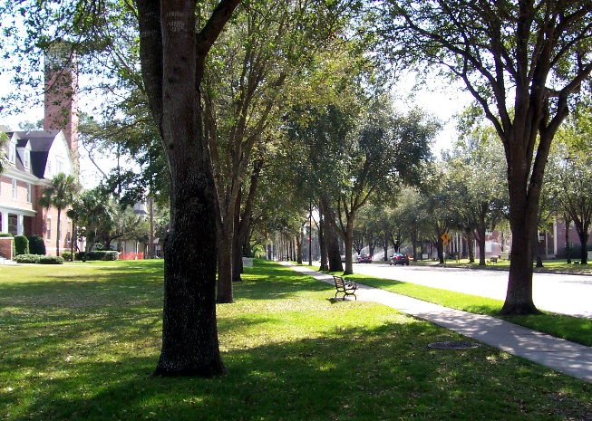
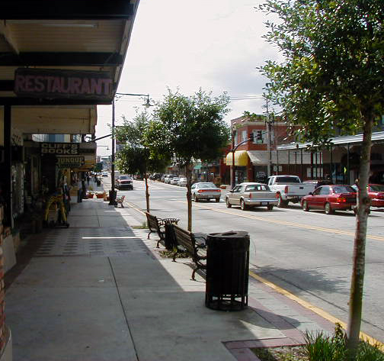
Livable Streets
None of the livable streets had offsets greater than 4 feet
Not a single injurious roadside crash on any of the livable street treatments
Not a single fatality occurred on any of these roadways

Slide 33
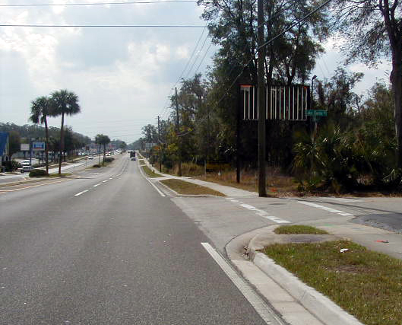
A Systems Approach: Systematic Crash Reconstruction
Field examination (Florida) of roadside crash locations:
83% of tree and pole crashes occurred behind an intersection or driveway on higher-speed roadway sections.
Illustrative Urban Fixed-Object Crash

Slide 34
Urban Roadside Crashes
Systematic Pattern:
Higher operating speeds along primary arterial
Driver attempt to turn onto a driveway or side street at higher speeds
Approach speed results in a roadside encroachments across the adjacent driveway or side street
Representative Urban Fixed-Object Crash

Slide 35
Latent Error
Organizational Factors
Functional Classification
Design Speed
Driveway and Development Policy
Clear Zone Policy

Slide 36
a Model For Safe Systems
Part 4: Conclusion

Slide 37
A Model for Safe Systems
Engineering Defenses
Organizational
Environmental
Individual
Management Decisions and Organizational Processes
Error-Producing Conditions
Errors and Violations
Crashes
Zoning Ordinances
Subdivision Regs
Regional Dev. Plans
Functional Class
Performance Measures (LOS)
Geometric Design
  Design Speed
  Design Vehicle
Traffic Control
Driveway Policies
ROW Allocation
  Bike
  Ped
  Transit
Education
Licensure
Enforcement
Legal Sanctions
Passive safety
Intelligent vehicles
Traversable hardware

Slide 38
FAU Activities: From Roadmap
Identifying the Safety Information Needs of Major Cities in the U.S.
  This study seeks to understand how cities in the U.S. address the issue of traffic safety, as well as to identify the research, information, and guidance they view as being most essential to advancing their safety needs.
Safe Systems Synthesis & Summit Phase 1
  This effort will entail a review of the literature on safe systems and a leadership summit to engage key stakeholders in the development of a single, working definition of the safe systems concept.
Completing the Picture of Traffic Injuries: Understanding Data Needs and Opportunities for Road Safety (Led by UT-K)
  To complete the picture of crashes and determine which elements of data that exist outside of conventional crash data can contribute to this picture, and to identify innovative statistical, probabilistic, and big data visualization tools to link crashes with other records.

Slide 39
Identifying the Safety Information Needs of Major Cities in the U.S.
Area 1:

Slide 40
R1: Status
Focus Group: 10/30/2017
    We are repeating the mistakes of the past…
Survey: Pending

Slide 41
Safe Systems Summit and Literature Review
Area 2:

Slide 42
Literature Review: Elements
  Open vs. Closed Systems
  Defining Errors/Risk
  Latent Factors (Systematic Error)
  Speed Management
  Self-Explaining Roads (Schema/Schemata)
  Safety Culture
  Models and Processes

Slide 43
Safe Systems Summit
Part 1: Safe Systems Concepts
Part 2: Implementation

Slide 44
SUMMIT PART 1: CONCEPTS
Systems Perspective
    KEYNOTE: Organizational/Systems Theory (James Reason)
    Safety-Conscious Planning (Michael Meyer/Susan Herbel)
Safe Speeds (Leah Shahum)
Safe Streets (Janette Sadik-Khan)
Safe Users
    Safety Culture (Nicholas Ward)
    Social Science/Traffic Psychology Perspective
Safe Vehicles
    Vehicle Manufacturers
    Connected/Automated Vehicles

Slide 45
SUMMIT PART 2: IMPLEMENTATION
Industry Roundtable
  NACTO
  Vision Zero Network
  AASHTO
  ITE
City Roundtable
  NYC
  Chicago (?)
  Los Angeles (?)
  Fort Lauderdale (?)

