Slide 1
An Enhanced Systemic Approach to Safety:
A systemic approach to support a Safe System
Presented by:
Offer Grembek
Joy Pasquet, GSR
Catalina Vanoli, GSR
January 24, 2018

Slide 2
A continuum of approaches to improve safety
From Reactive to Proactive
Reactive
Proactive
Spot
Corridor
Systemic
Safe System, Vision Zero

Slide 3
A continuum of approaches to improve safety
From Reactive to Proactive
Reactive
Proactive
Spot
Corridor
Systemic
Safe System, Vision Zero
Spot Safety:
Improvement at a specific location in response to a-higher-than-expected crash rate at a site

Slide 4
A continuum of approaches to improve safety
From Reactive to Proactive
Reactive
Proactive
Spot
Corridor
Systemic
Safe System, Vision Zero
Corridor Safety:
Improvement across a corridor in response to a-higher-than-expected crash rate, or recurring safety concerns along a corridor

Slide 5
A continuum of approaches to improve safety
From Reactive to Proactive
Reactive
Proactive
Spot
Corridor
Systemic
Safe System, Vision Zero
Systemic Safety:
“An improvement that is widely implemented based on high-risk roadway features that are correlated with particular crash types” FHWA

Slide 6
A continuum of approaches to improve safety
From Reactive to Proactive
Reactive
Proactive
Spot
Corridor
Systemic
Safe System, Vision Zero
Safe System, Vision Zero:
Safe System
“Building a system in which people cannot be fatally or severely injured on despite human error” Soames Job

Slide 7
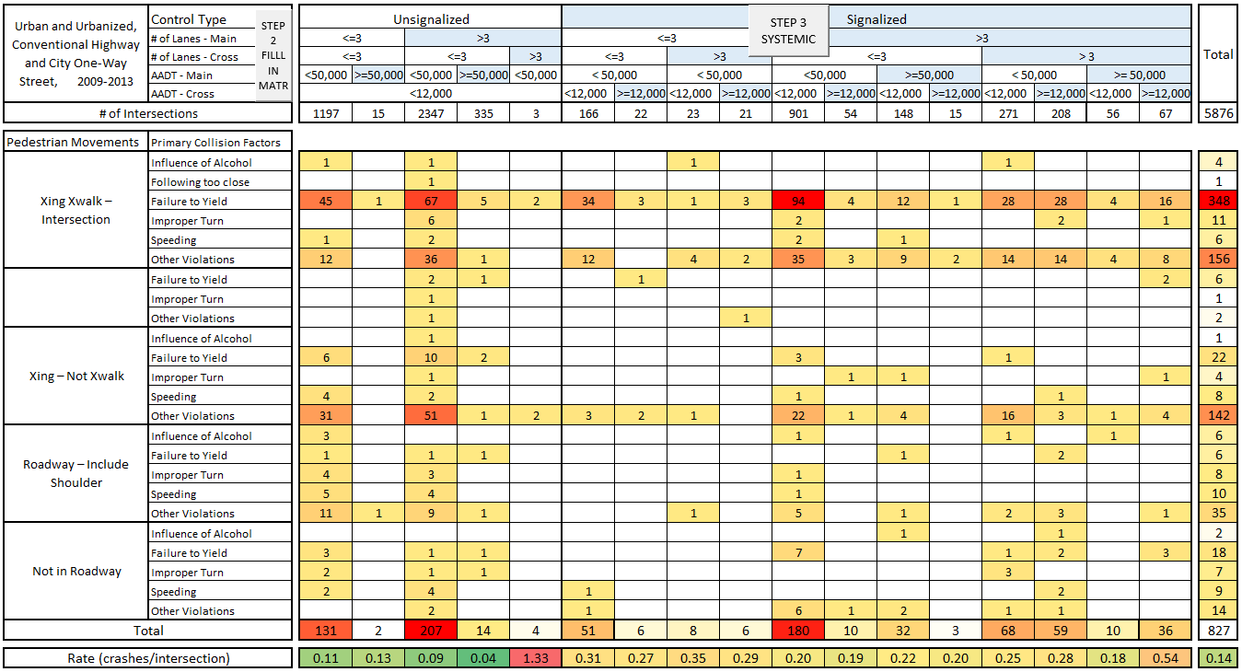
A systemic matrix approach
Facility Types
Crash Types
* Systemic pedestrian matrix developed by SafeTREC for Caltrans

Slide 8
A systemic matrix approach
Facility Types
Crash Types
* Systemic pedestrian matrix developed by SafeTREC for Caltrans

Slide 9
A systemic matrix approach
Facility Types
Crash Types
Systemic hotspots
* Systemic pedestrian matrix developed by SafeTREC for Caltrans

Slide 10
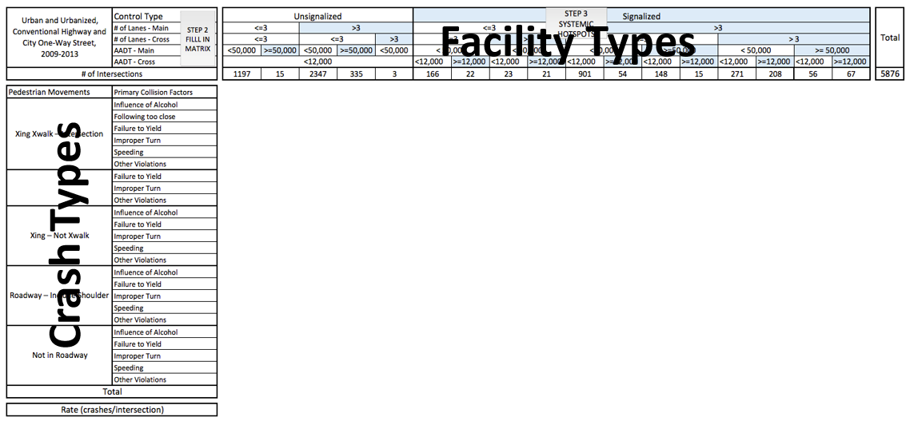
Project goals and activities
1
Enhance methods to identify systemic safety concerns
Develop method to determine crash types and the facility types that need to be included in a matrix for a specific mode
populate mode-specific crash matrices using the data from multiple states
Matrix Structure
System snapshot

Slide 11
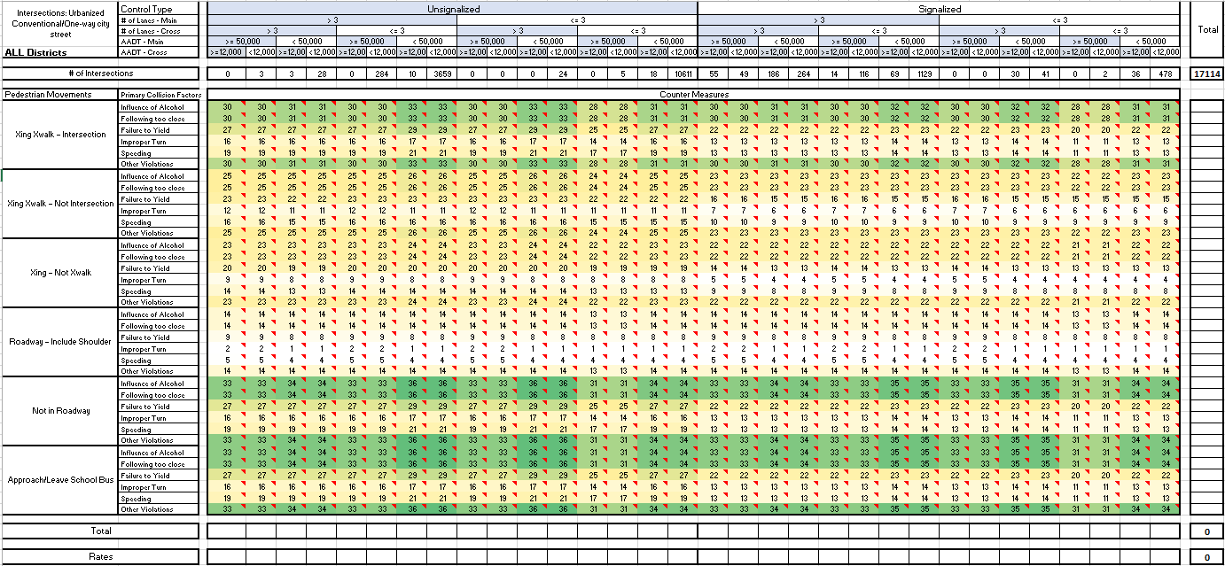
Project goals and activities
2
Enhance countermeasure scope to include engineering and non-engineering improvements
develop a list of engineering safety countermeasures to address crash profiles identified for the different matrices
develop a list of non-engineering improvements to address crash profiles identified for the different matrices
Engineering CM’s
Non-Eng. CM’s

Slide 12
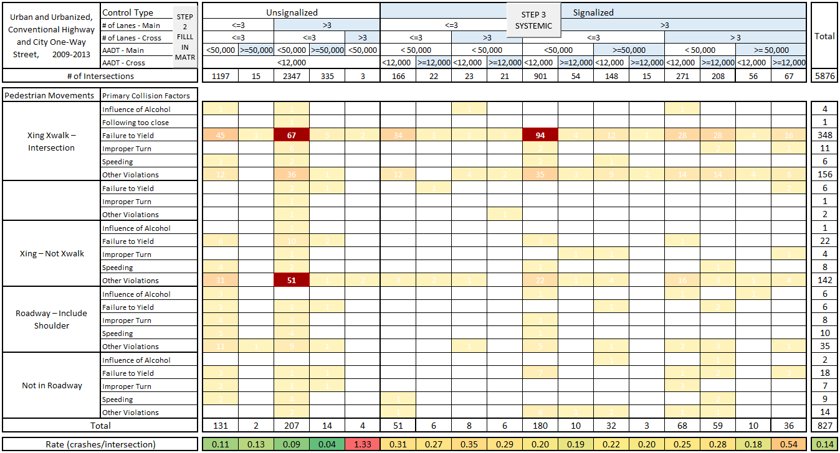
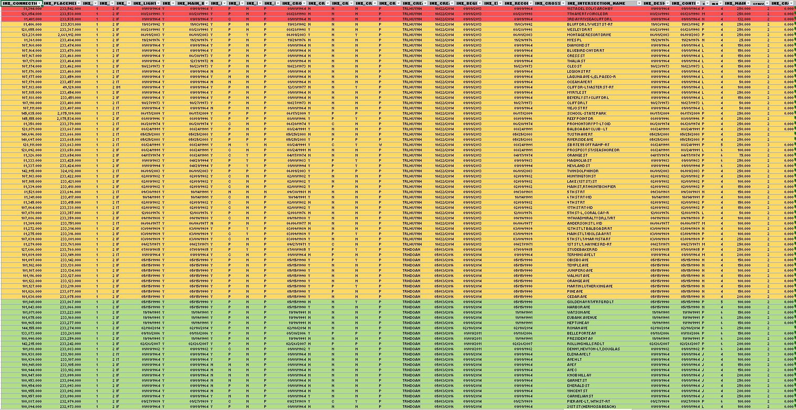
Project goals and activities
3
Enhance process to determine high priority locations
explore the advantages and disadvantages of different methods to identify systemic hotspots
define guidelines for determining upper and lower thresholds for systemic projects
Systemic priorities
Refine location list

Slide 13
Project goals and activities
1
Guidelines for determining matrix
structure across different modes
Modal matrices
2
Basic toolbox for engineering and
non-engineering improvements
CM matrices
3
Considerations for screening criteria
for systemic projects
Priorities

Slide 14
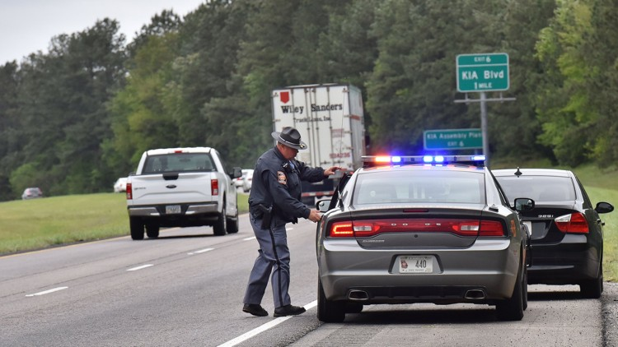
Enforcement countermeasures
How can it be used?
Police enforcement targeted at the identified problematic facilities
What is the promise?
Filling the gaps in the driving code
What are the limitations?
Burdensome state by state legislative analysis
Guidelines for future considerations
Notes:
Initially, thought that it might help police officers just go to the problematic facilities and look for a certain type of violations.
Enforcement does not designate how the driving code itself is enforced by police officers, but rather the content of the code. Although legislation is variable from state to state, digging into each state’s driver’s handbook (for the 7 states covered by HSIS) and studying the structure of the driving code may give insights as to which problematic behaviors that have been identified by the tool are addressed in the code, or if there is a gap. For each facility type and crash type, indicate in the cells how many driver’s code items are covering the problematic behavior (if any), or if there is a gap to be filled (new codes to add).

Slide 15
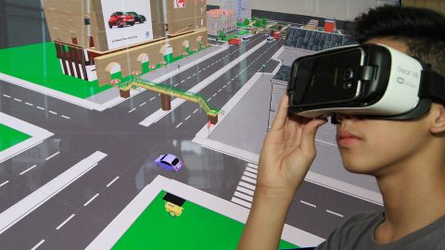
Education countermeasures
How can it be used?
Elaborating an educational countermeasures matrix
What are the limitations?
Multitude of entities involved in road safety trainings
What is the promise?
Lead the development of learning modules
Guidelines for future considerations
Notes:
It would be complicated to identify what educational countermeasures are already being implemented because of the multitude of stakeholders involved, be it institutional (at the federal/state/local level, schools) or not (associations, etc.). But the tool could lead to the development of learning modules targeted at issues identified in the matrix. In a long-term perspective, this approach could benefit from partnerships with other stakeholders, to see if their respective programs already tackle the identified issues, and if not, help them integrate these in their learning programs.

Slide 16
Data requirements
Three categories of data
Crash data (rows)
Roadway data (columns)
Operations data (columns or risk)
Source: HSIS (Highway Safety Information System) files
accident subfile
vehicle/occupant subfiles
roadway file
intersection file
Challenge: linking the data

Slide 17
Data collection
HSIS Data for 5 years across 7 states:
California 2010 - 2014
North Carolina 2010 - 2014
Ohio 2011 - 2015
Washington 2011 - 2015
Illinois 2006 - 2010
Minnesota 2006- 2010
Maine 2011 - 2015
Data cleaning in Python
Notes:
spread across the files mentioned
here, files for CA

Slide 18
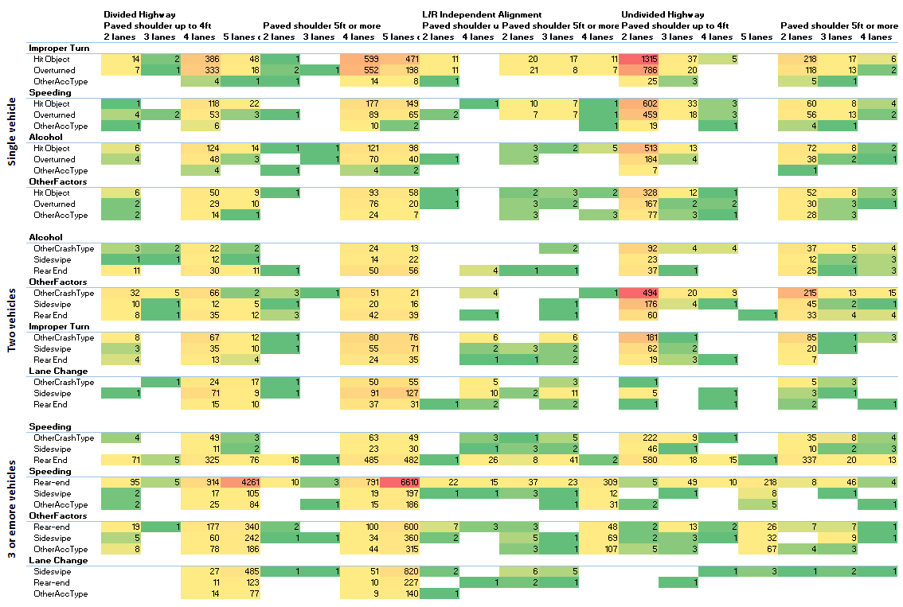
What did we do with all the data?

Slide 19
What did we do with all the data?

Slide 20
What did we do with all the data?

Slide 21
What did we do with all the data?

Slide 22
What’s next?
Frequency
Density
Rate
Matrix 1
Matrix 2
Matrix 3

Slide 23
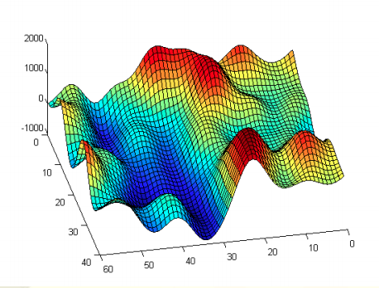
What’s next?
Frequency
Density
Rate

Slide 24
Comments
Discussion
Questions

