Slide 1
R4: Completing the Picture of Traffic Injuries: Understanding Data Needs and Opportunities for Road Safety
Project Start Date: 2017-03-01 | Project End Date: 2018-02-28

Slide 2
Primary Objectives:
Develop a complete the picture of crashes and determine which elements of data that exist outside of conventional crash data that can contribute to this picture. These elements likely include EMS, ED, DMV, Health Expenditure, Census, and Land Use, among others.
Identify innovative statistical, probabilistic, and spatial data visualization tools to link crashes with other records, either by record-matching, or augmenting datasets based on spatial or temporal indicators to perform more-advanced safety analysis
Perform five applications

Slide 3
Previous Example
In USA at State level:
Crash Outcome Data Evaluation System (CODES)
Crash Medical Outcomes Data Project (CMOD)

Slide 4
CODES
Aim is to Link crash, vehicle, and behavior characteristics to their specific medical and financial outcomes
Provide a comprehensive understanding of motor vehicle crash outcomes
CODES data reside in the States where the linkage originated, and NHTSA does not disseminate CODES data.
Conducted in 15 states (2013)
Methodology varies by states (Probabilistic and Deterministic) .
Limitations of CODES or similar program (e.g., CMOD)
Only considered health-oriented database and police databases

Slide 5
Literature Review
Linkage Methods:
Interface
Real time interaction between databases
Need Compilation of data from multiple agencies
Direct Method
Databases Share a unique single identifier
E.g., SSN, License Number
Difficulty to access data; Health Insurance Portability and Accountability Act (HIPAA)

Slide 6
Literature Review
Deterministic Linkage
Multiple quasi-unique fields that describe an individual who was involved in an MVC: Time and Geographical data elements, gender, age
Need a scoring system (based on researchers’ Judgment) to identify the matches
Probabilistic Linkage
Aim: generate the probability that a pair of records describe same person and event.
Address the Judgments’ concerns
It is the current practice in CODES program
Spatial method

Slide 7
Studies Classification
Linking Police Crash databases and Hospital Oriented Data Applications
The studies could be categorized into:
Comparison Of The KABCO Scale and AIS Injury Severity Scale.
Factors Influencing Injury Severity
Underreporting of Traffic Crashes
Substance Abuse and Motor-Vehicle Crashes
Evaluation of Safety Equipment
Analyzing Specific Road User traffic crashes

Slide 8
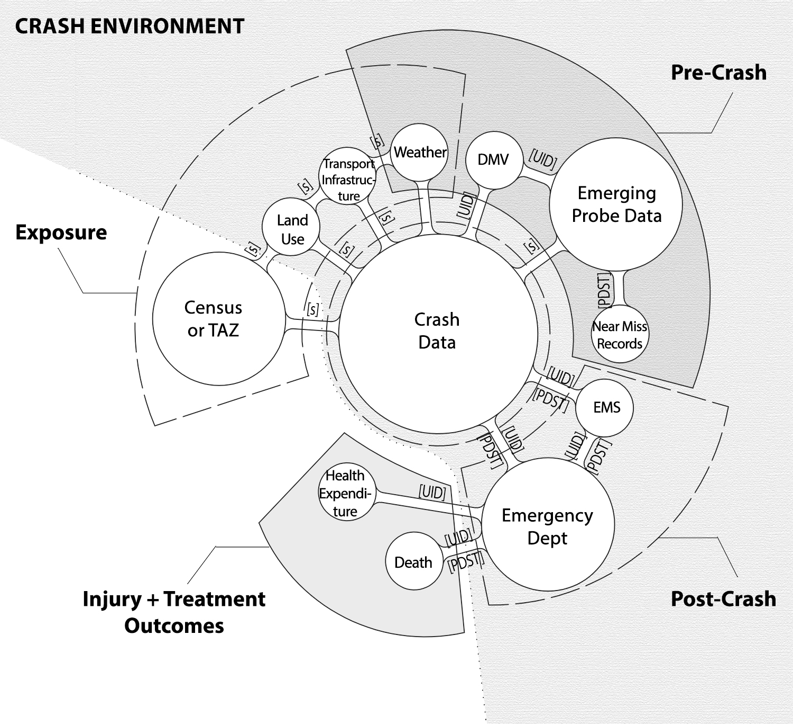
Introducing Databases
Description of the database
How to access the database w/wo PHI
Consistency between state/local
Variables within the dataset

Slide 9
Exhaustive (?) List of Databases
Police Crash data
Injured person data
EMS
Emergency Department (Trauma)
In-patient hospital
Death records
Census Data (& TAZ)
Land Use (zoning, parcel-level)
Transport infrastructure and traffic counts
Weather
DMV
Vehicle data (OBD, CAV-emerging, event data, etc)
Traffic citations
Probe data or naturalistic data
Self report (crowdsource) or near miss
Justice department criminal histories
Health expenditure
Prescription Drug Monitoring

Slide 10
Data Descriptions
Each dataset will be outlined in report
Access (PII)
National Standards and State Consistency
Variables types in database
Linking Methods
Master Database | Secondary Database
 | Police Crash (C) | Near miss records (N) | emerging probe data (P) | DMV (D) | Transport Infrastructure (T) | land use (L) | Census/ TAZ (N) | HDDS (X) | Emergency Dept. (E) | Death (F) | EMS (M)
Police Crash (C) | 0 |  | S | U | S | S | S | PU | P U | U P | P U
Linking code name |  |  | 13CPS | 12CDU | 11CTS | 10CLS | 09CNS | 01CXU 02CXP | 03CEU 04CEP | 05CFU 06CFP | 07CMU 08CMP
Notes:
U is for Unique identifier (e.g., SSN, name, date of birth), we use deterministic linkage to link the databases.

Slide 11
Case Studies
Case Study 1: Underreporting Bike/Ped
Case Study 2: EMS Response Time
Case Study 4: Aggregate Crash Prediction Model
Case Study 3: Accessibility Measures and Safety
Case Study 5: Seat Belt Use

Slide 12
Complete Picture – UC Berkeley Component
Builds on existing effort to perform road safety research that explores core safety issues. This project addresses post-crash issues by considering EMS, ED, and hospital data.
The project will support the development of data sets, i.e., linked crash and medical data, which are designed to (i) clarify the true burden of pedestrian and bicyclist injury (Case 1) and (ii) improve post-crash management of injury (Case 2).

Slide 13
CASE STUDY 1 Linking Crash and Post-Crash Data to Get a “Complete Picture” of Pedestrian/Bicyclist Injury
Rationale:
Crash reports submitted by police are primary sources of data to assess pedestrian and bicyclist injury and to develop countermeasures.
A number of studies have identified pedestrian and bicyclist injuries that are not recorded in police reports.
Linking police reported and medical data can provide a more “complete picture” of pedestrian and bicyclist injury

Slide 14
CASE STUDY 1 Linking Crash and Post-Crash Data to Get a “Complete Picture” of Pedestrian/Bicyclist Injury
Year 1 Activity
Literature review and bibliographic summary of previous articles/reports linking police reported pedestrian/bicyclist injury and medical data describing pedestrian/bicyclist injury
Critical review of this literature focusing on findings and methodological issues and solutions related to matching procedures.

Slide 15
CASE STUDY 2 Develop measures of EMS response times (time from crash to dispatch, time from dispatch to arrival of EMS crew, time on site, time to ED, etc.) as a function of rural versus urban, cell phone coverage, trauma center location, etc.
EMS response time has been identified in some studies as a factor influencing degree of injury and probably of fatality.
A review of distances between crashes in California and the nearest trauma center/ER indicates potential times of up to three hours.
There is a least anecdotal evidence of even longer times bases on communication and other issues.
There is a need to document actual response times as a function of distance and other factors.

Slide 16
CASE STUDY 2 Develop measures of EMS response times (time from crash to dispatch, time from dispatch to arrival of EMS crew, time on site, time to ED, etc.) as a function of rural versus urban, cell phone coverage, trauma center location, etc.
Year 1 Activities
Literature review and bibliographic summary of articles/reports that address impact of extended response time and factors influencing response time and other quality of on-site care.
Critical review of this literature focusing on findings and methodological issues in studies of response times and in studies of implications of response time and other factors on outcomes.

Slide 17
CASE STUDY 4
A New Approach to Aggregate Crash Prediction Model: Home-Based Crash Frequency Modeling

Slide 18
Aims of the study
Identify neighborhoods that have higher risk of involvement in traffic crashes (hotspots)
Investigate the relationship between socio-demographic variables and risk of involvement in traffic crashes.
Compare new definition with traditional definition of the road safety
Current definition of road safety (i.e., Location-Based Approach)
"the number of accidents (crashes) by kind and severity, expected to occur on the entity during a specified period.”(Hauer 1997)
Instead we used (Home-Based Approach):
The expected number of crashes that road users who lives in a certain geographic area have during a specified period.

Slide 19
Database
Databases
Census Tract Data of TN
Highway Performance Monitoring System
Police Crash Report in TN
We used Spatial Join to merge databases
Model: Random Effect Negative Binomial Model
to investigate the relationship between sociodemographic variables and risk of involvement in traffic crashes at zonal level

Slide 20
New Definition
Current definition of road safety (i.e., Location-Based Approach)
"the number of accidents (crashes) by kind and severity, expected to occur on the entity during a specified period.”(Hauer 1997)
Instead we used (Home-Based Approach):
The expected number of crashes that road users who lives in a certain geographic area have during a specified period.

Slide 21
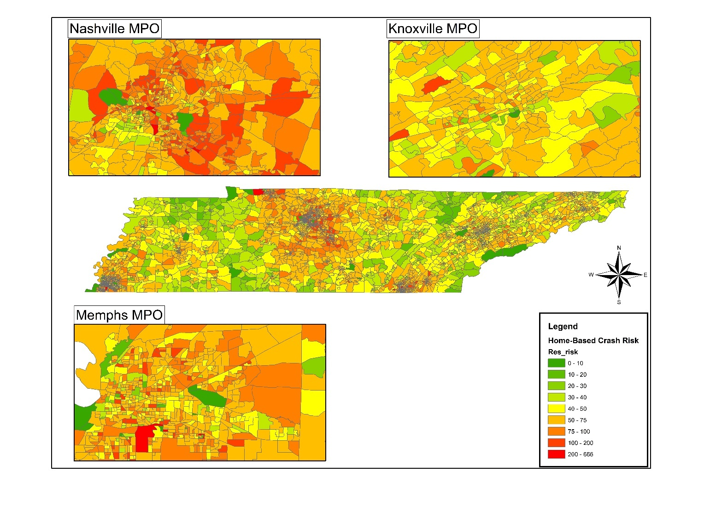
Comparing Crash Risk*
Location-Based Approach vs Home-Based Approach
*Crash Risk: Crash Frequency divided by 1000 population
Correlation between HBA and LBA crash frequency: 0.19 (p value = 0.000)

Slide 22
ACPM: Case Study of Tennessee
Variable | LBA | HBA
Total population | .000223*** | .000485***
Age cohort
16-42year | 1.25*** | .31***
42-59years |  | .54***
60 years old and more | .799***
Race
White | -1.01*** | -.557***
Black | -.987*** | -.329***
Hawaiian | 3.69*
Transportation mode to travel to work
Personal vehicle | .565***
Bus | 1.09**
Walk | 1.78*** | -.834***
Average travel time work | -.0184*** | .00673***
Education
High school or less |  | .591***
Some College degree | .662*** | 1.1***
Bachelor’s degree | .324** | .99***
Household’s Vehicle ownership
No vehicle | 1.24***
One vehicle | .751*** | .666***
Two vehicle |  | .568***
Three vehicle or more | -.385** | .419***
VMT | 7.22e-06*** | 6.72e-07***
Density | .00824*** | .000767***
Metropolitan Indicator | .23*** | .249***
chi2 | 3175 | 6391
df
N | 4125 | 4125
aic | 38553 | 38543
legend: * p<.05; ** | p<.01; *** p<.001
DV: HBA: Number of Crashes per population among residents of a Census Tract
DV: LBA: Number of Crashes that Occurred in a Census Tract
Findings are discussed in details in the case studies

Slide 23
CASE STUDY 3
Relationship Between Built Environment And Risk of Involvement In Traffic Crashes

Slide 24
Why does accessibility matter for safety?
Research on sprawl suggests that those who living in more sprawling counties are more likely to be in fatal accidents
The primary expected mechanism for this is higher VMT
Greater sprawl -> higher VMT -> greater exposure to fatal crashes
Accessibility is the built environment variable with the strongest relationship with VMT
Higher accessibility environments are associated with reduced VMT
Therefore high accessibility at the residential location may be associated with reduced vehicular crash risk
High pedestrian and bike accessibility at one’s residential location may be associated with greater pedestrian/bike crash risk

Slide 25
Accessibility vs. Density
Density is a highly localized measure of the built environment
Accessibility is a regional measure that indicates overall regional proximity to destinations
Therefore density may be a more relevant built environment measure for crash locations
Accessibility may be a more relevant measure for residential locations because most people’s activity space spans significantly beyond their home location
As a regional measure, accessibility may also correlate with a person’s generalized exposure to regional traffic
Persons who live in a high accessibility environment are surrounded by many destinations, and therefore travel in high-traffic environments
Persons who live in a low accessibility environment are surrounded with few destinations, and therefore travel in low-traffic environments

Slide 26
Aims of the study
Investigate the relation between accessibility (job and population) and Safety
Investigate the relation between density (job and population) and Safety
Model: Spatial Error Model
to investigate the relationship between built environment and driver crash frequency at zonal level

Slide 27
Databases
Knoxville Regional Travel Demand Model
Police Crash Report in TN 2016
Highway Performance Monitoring System
Spatial Join
Geocoding process; similar to the previous case study

Slide 28
Driver risk of involvement in traffic crash
Driver Crash per 1000 population

Slide 29
Spatial Error Model
Dependent Variable: Driver Crash Freq. at TAZ Level
Variable | Coef. | Std. Err. | z | P>|z|
Vehicle per Household | 3.308 | 1.006 | 3.290 | 0.001
Total Population | 0.050 | 0.001 | 98.870 | 0.000
Average Median Household Income | 0.000 | 0.000 | -6.360 | 0.000
university Student Population | -0.008 | 0.002 | -3.190 | 0.001
Tourist attractuib | 6.594 | 2.327 | 2.830 | 0.005
Percent Pay Parking | -28.638 | 11.154 | -2.570 | 0.010
Population Density | -0.002 | 0.000 | -9.610 | 0.000
Employment Denisty | 0.000 | 0.000 | 2.680 | 0.007
Job acc. Wihtin 10 minutes | -0.001 | 0.001 | -1.710 | 0.088
Population acc. Wihtin 10 minutes | 0.000 | 0.000 | 3.330 | 0.001
Cosntant | -4.798 | 5.377 | -0.890 | 0.372
lambda | 0.90554 | 0.08530 | 10.62 | 0
Findings are discussed in details in the case studies

Slide 30
CASE STUDY 5
Police Crash Reports as A Source to Examine Seat Belt Use Rate Distribution in The Neighborhoods

Slide 31
Aims of the study
Identify seat belt use hotspots in TN at zonal level
Investigating the relationship between sociodemographic variables and seat belt use rate at zonal level based on the home address of the individual
Study group:
Road users over 16 years old who were involved in traffic crash in TN in 2016 (i.e., driver or passenger)
Model: Tobit Model
to investigate the relationship between sociodemographic variables and driver/passenger seat belt use rate at zonal level

Slide 32
Seat Belt Use Distribution
Databases:
Police Crash Report
US Census
Spatial Join
Geocoding process; similar to the previous case study

Slide 33
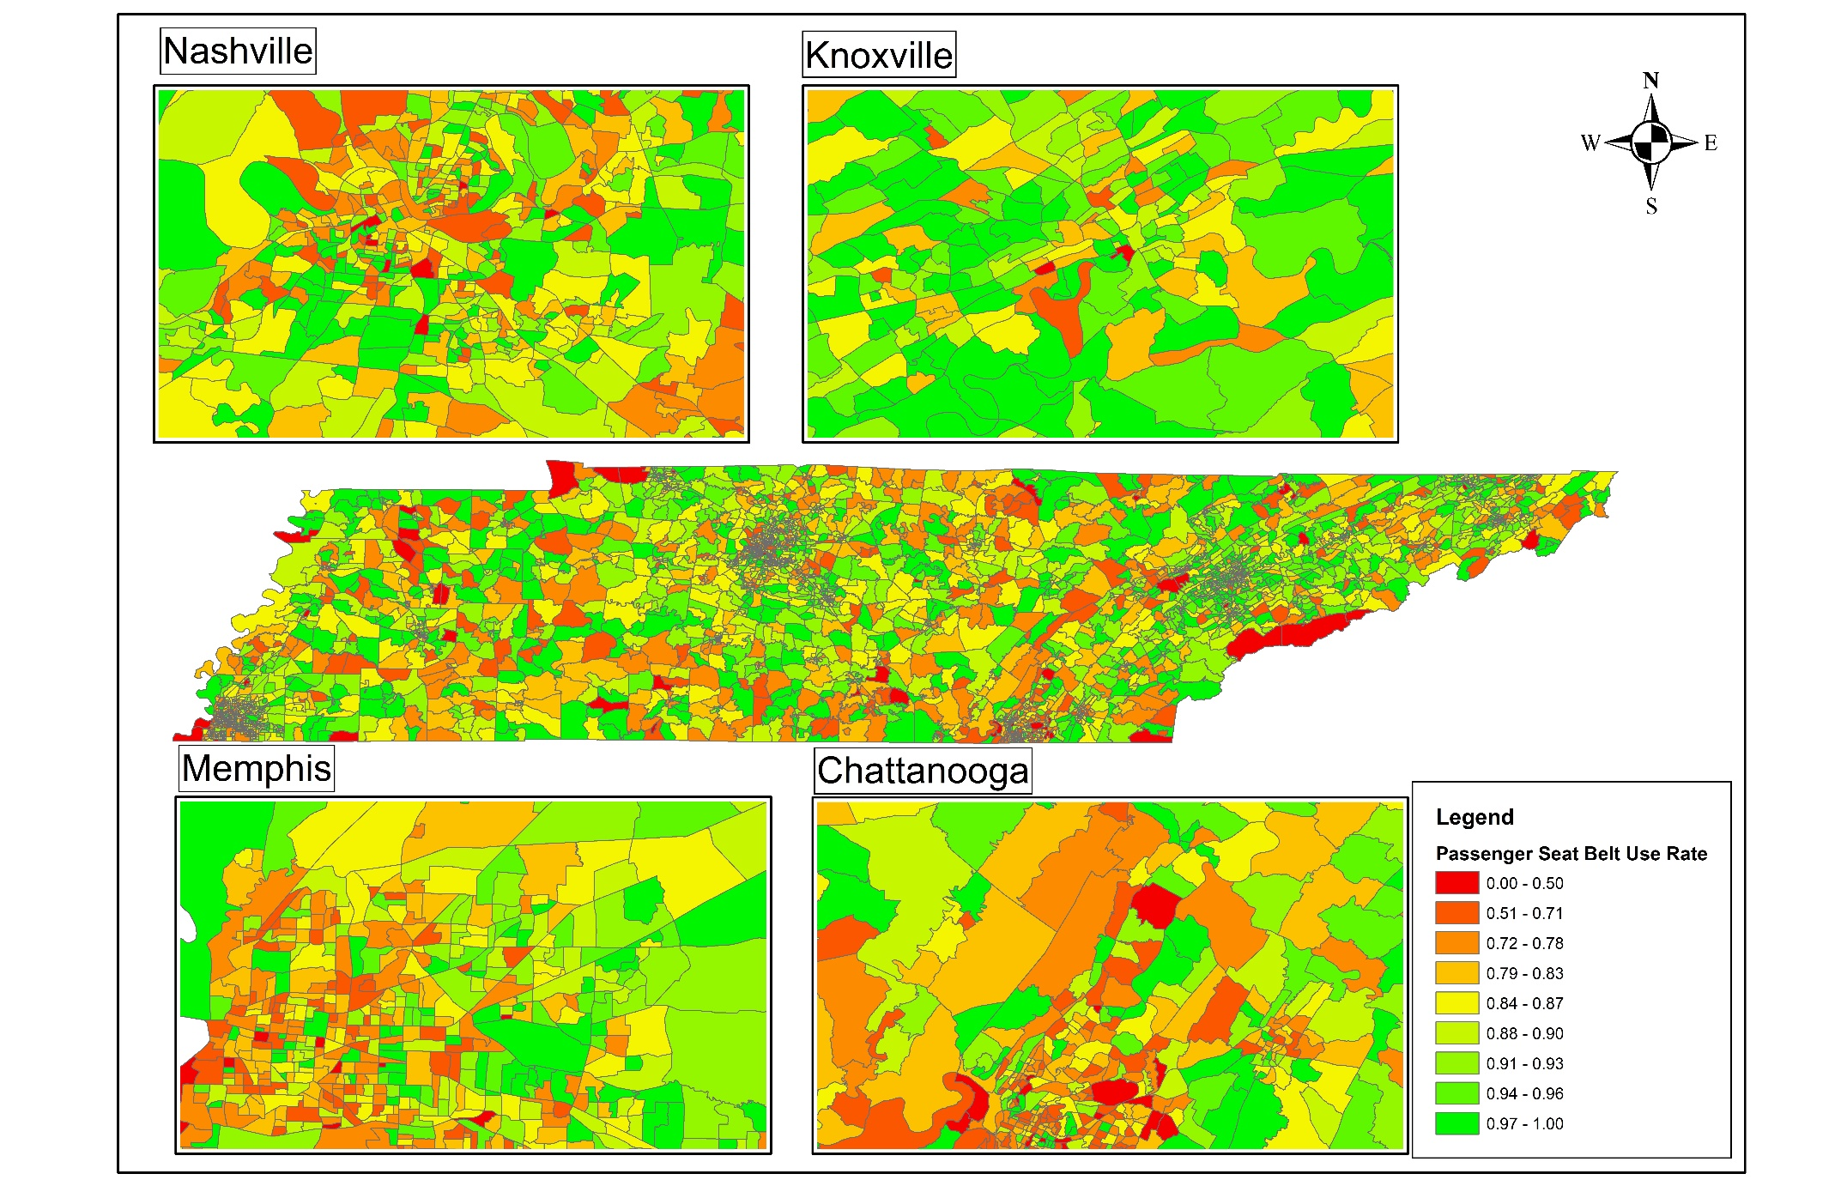
Seat Belt Hot Spots
Driver vs Passenger

Slide 34
DV: Seat Belt Rate Rate for
Variable | Driver Seat | Passenger Seat
Total Population | 5.97e-06*** | 5.03E-06
Age Cohorts
% Population Under 16 | -.108***
% Population 16-42 | -.0451*
Race
% Race White | .0323*** | .0504***
% Children | .133*** | .0699**
Education Degree
% High School Degree | -.0288***
% College Degree | -.0538***
% Bachelor Degree | .0484**
Household Vehicle Ownership
No Vehicle | -.0847***
One Vehicle | -.0293*** | .0979***
Two Vehicles | -.0282** | .08***
Three Or More Vehicles | .0846***
Metropolitan Indicator | .00545* | .0105*
Morning Share Carpool | -0.034
Household Size | -.00138***
Median Household Income | -1.62e-07*
Constant | .903*** | .724***
Var (Driver Seat) | .00359***
Var (Passenger Seat) |  | .0138***
Statistics
chi2 | 362 | 205
AIC | -11464 | -5863
legend: | * p<.05; ** p<.01;*** p<.001
Findings are discussed in details in the case studies

Slide 35
Reporting and Next Steps:
Finish report (March-April)
Publish, Publish, Publish!
Present work at technical meetings (e.g. ITE)
Disseminate results to stakeholders through webinars and CSCRS/SafeTREC/CTR educational and professional development outlets.

Slide 36
Follow-up Work

Slide 37
CASE STUDY 1 Linking Crash and Post-Crash Data to Get a “Complete Picture” of Pedestrian/Bicyclist Injury
Proposed Year 2 Activities
Obtain data files linking crash and medical data (CMOD, or Crash Medical Outcome Data) developed by the California State DPH to evaluate the degree to which crash data (i.e., police collision reports) under-report crash injuries.
Focus on pedestrian/bicyclist injury, identifying factors (e.g., age, ethnicity, geographic area) associated with level of reporting.
Focus on evaluating level of crash reporting of pedestrian/bicyclist injury on tribal areas in California

Slide 38
CASE STUDY 2 Develop measures of EMS response times (time from crash to dispatch, time from dispatch to arrival of EMS crew, time on site, time to ED, etc.) as a function of rural versus urban, cell phone coverage, trauma center location, etc.
Year 2 Proposed Activities
Begin analysis of data already obtained from CEMIS (California EMS Information System) to evaluate time elements in EMS response from the time of the crash to the time of arrival at an emergency department or trauma center.
Obtain addition data listed in the NEMSIS Uniform EMS Dataset as needed from CEMSIS to explore how factors such as location of EMS unit, type of treatment provided at the scene, etc. impact time elements.
Prepare a detailed report showing EMS response times as a function of crash location, ED/trauma center location, and other factors. Highlight the factors that might be modified (e.g., cell phone coverage, placement of EMS response unites, etc.) to improve EMS response. This could take the form of a statistical model of EMS response in California that can identify the factors most likely to have a beneficial impact on improved injury outcomes.
As a subpart of the above goals, look specifically at EMS response times in tribal areas in California (note: in a study of traffic safety in tribal areas in California, EMS response has been noted as a particular issue).

Slide 39
CASE STUDY 3 & 4
Year 2: Integrating Spatial Safety Data into Planning Processes
Extend the Home-based Safety safety approach integrate into planning process
Expand attribution of crash causal behaviors to neighborhood profiles.
Integrate ”crash generation” concepts into transportation planning processes (akin to “trip generation” concepts) and test on one metro planning model.

Slide 40
CASE STUDY X
Year 2: Opioids at the health and transportation safety nexus.
Explore integration of crash, health, and prescription drug monitoring datasets across critical states
Health system map: opioid → traffic safety → opioid → health outcome
Identify capabilities of datasets and institutions to answer questions related to opioid health system map.

Slide 41
Questions

