Slide 1
R1: Structures of Stakeholder Relationships in Making Road Safety Decisions CSCRS Research Call, April 25, 2018 Seth LaJeunesse

Slide 2
R1 Project Team
UNC HSRC
Seth LaJeunesse
Stephen Heiny
UNC IPRC
Steve Marshall
Kelly Evenson
Becky Naumann
UC Berkeley
Jill Cooper
Sarah Doggett

Slide 3
Project Purpose
To uncover effective, efficient, and equitable relationship network structures that ultimately result in high quality transportation safety decisions
To accelerate the adoption of safe systems approaches throughout the United States
Notes:
How does this fit into the overall

Slide 4
Research Questions
Which US cities serve as “opinion leaders” in traffic safety?
What are cities’ intentions—i.e., plans—related to traffic safety?
Which organizations and actors are involved in influencing the safety of cities’ transportation systems?
How do these organizations and actors make transportation safety decisions and what is the quality of these decisions?
Notes:
How does this fit into the overall

Slide 5
Relationship to CSCRS Focus Areas
Integrated Systems Approaches: implementing multi-disciplinary strategies based on a model that acknowledges the complexity of the relationships between individual, organizational, and policy levels
Transportation Workforce Culture: requires broadening the set of professionals who understand the importance of road safety and identifying effective training strategies and tools for all practitioners

Slide 6
R1 Project Phases
Phase I: Practitioner survey
Phase II: Content analysis of cities’ Vision Zero plans
Phase III: Detailed organizational network analysis

Slide 7
Phase I: Practitioner Survey

Slide 8
Practitioner Survey
Involved conducting a sociometric survey of “road safety professionals” (adapted from Dearing et al, 2017)
Planners
Engineers
Public health—predominantly injury prevention
Law enforcement
Emergency response
Based on Diffusion of Innovations Theory insight— adoption of any innovation (e.g., safe systems) is never random or instantaneous, but rather follows predictable patterns of social influence

Slide 9
Phase I: Practitioner Survey
1,738 individual contacts
384 professionals willing to participate in the survey
334 professionals whose work involved “understanding or improving the safety of people on roadways”
183 professionals provided complete responses

Slide 10
Core Survey Questions
Please list up to three…
Individuals
Organizations; and
Municipalities
outside of your organization/municipality whose example or reputation you follow with respect to their work on reducing roadway fatalities and injuries

Slide 11
Select Survey Results
A nation-spanning, inter-city advice network related to traffic safety exists
Our sample is composed of 230 cities with 372 ties among them
50.4% of ties cross regional Census boundaries (i.e., West, Midwest, Northeast, South)
Network densities are highest among Northeast cities; lowest among cities in the South

Slide 12
Inter-City Advice Network

Slide 13
Opinion-Leading Cities
In order of in-degree centrality:
New York, NY
Portland, OR
Seattle, WA
San Francisco, CA
Minneapolis, MN
Washington, DC
Boston, MA
“When opinion leaders do not adopt an innovation, systems do not change” (Dearing and Cox, 2018, p. 184)

Slide 14
Boundary-Spanning Cities
In order of betweenness centrality:
New York, NY
Portland, OR
Minneapolis, MN
Seattle, WA
Attitudes and behaviors tend to be similar among homogenous groups
Boundary spanners tend to be more attuned to divergent ways of thinking and behaving.
Bridge-building across gaps between groups can offer insight into approaches otherwise not considered (Burt, 2004)

Slide 15
Phase II: Analysis of Cities’ Vision Zero Plans

Slide 16
Analysis of Cities’ Vision Zero Plans
Preliminary findings from content analysis of 14 cities’ plans:
Most cities with Vision Zero plans define safety problem in “global” terms
Most involve a diverse array of professionals in action planning
Few cities clearly link proposed interventions with identified safety problems
Few cities describe plans for performance management
Few cities employ systemic safety (i.e., proactive, risk-based) approaches
To be continued in a Year 2 project: R17 – “Strengthening Existing and Facilitating New Vision Zero Plans”

Slide 17
Phase III: Organizational Network Analysis

Slide 18
Organizational Network Analysis
Involved:
Coordinating with the Vision Zero Network to identify “key contacts” in four opinion-leading US cities—New York, Portland, Seattle, and San Francisco
Coordinating with each city’s key contact to identify people in the city’s “Vision Zero” network
Contacting the 8-15 people in each city’s Vision Zero network regarding contact frequency, productivity, and resource sharing among city agencies/organizations

Slide 19
Organizational Network Analysis – Contact Frequency
DRAFT

Slide 20
Organizational Network Analysis – Productivity
DRAFT

Slide 21
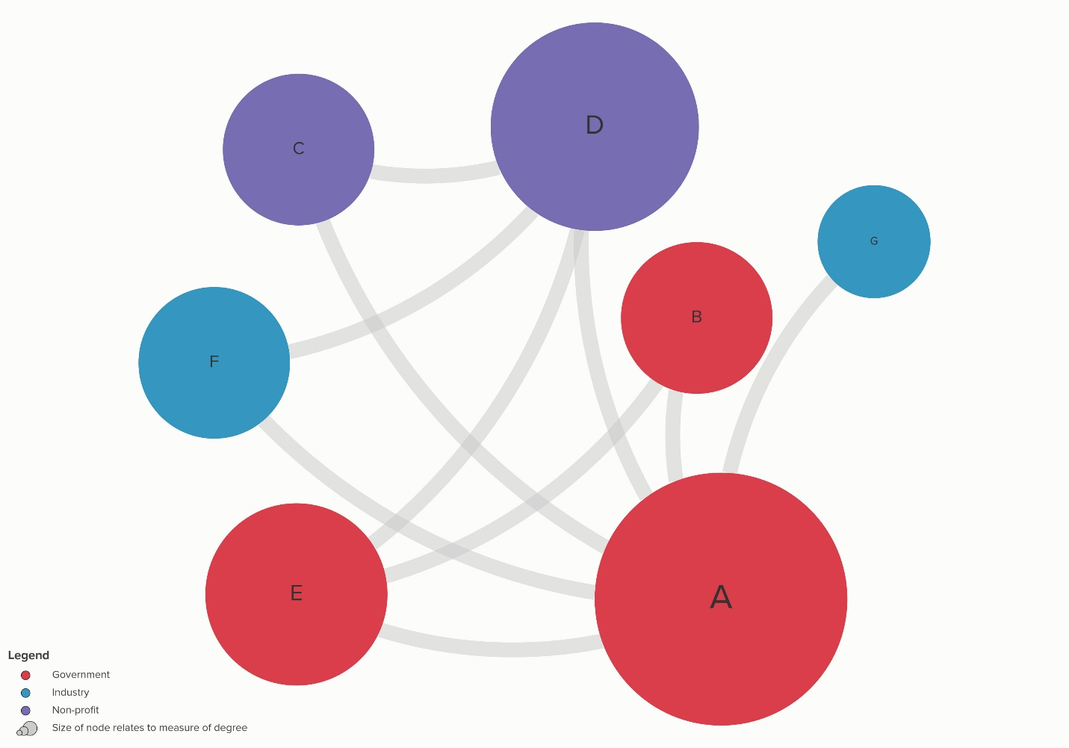
Organizational Network Analysis – Resource Sharing
DRAFT

Slide 22
Next Steps in Phase III
Write-up findings from organizational network analysis
Audit of three leading cities’—we have insufficient data for one city— safety projects over the past year
Assessing projects individually by:
Efficiency (cost effectiveness)
Effectiveness (safety-based evidence)
Equity (impacts on traditionally disadvantaged groups)
Assessing programs holistically by:
Clarity of links between identified problems and proposed countermeasures
Use of systemic or “risk-based” assessments in project prioritization and resource allocation

Slide 23
Products and Future Work
Products:
Detailed maps describing the structure of organizational network in four leading cities
Three academic reports explore professionals’ awareness of Vision Zero (i.e., Evenson, LaJeunesse, & Heiny, in press); depiction of a US inter-city advice network (soon to be submitted); and a framework for using network analytic methods to better understand and advance safe systems approaches
Informing Future Work:
technology transfer through engagement with opinion-leading cities
organizational self-assessment toward enhancing workforce relationships and networks

Slide 24
Thank you—Questions?

