Slide 1
Development and Evaluation of Vehicle to Pedestrian (V2P) Safety Interventions
Michael Clamann

Slide 2
Research Questions
Can an app be used effectively to advise pedestrians about safe street crossings?
Can a mobile app make crossing safer for distracted pedestrians?
What is the threshold of reliability that drives trust in the system? (or a lack thereof)
How can we leverage machine learning algorithms for human- centered design applications?
Photo: National Safety Council
Notes:
A rise in cell phone distracted walking injuries parallels an eight-fold increase in cell phone use in the last 15 years (NSC).

Slide 3
Project Tasks
Develop Mobile App
Alert pedestrians when they are near areas of high traffic density
Advise pedestrians when it is unsafe to cross a street
Test the App Prototype
Naturalistic experiment to measure effectiveness and reliability

Slide 4
Previous Examples
WalkSafe (2012)
Detects oncoming vehicles using smartphone camera
Honda “V2P communication system & method” (2015 patent)
Uses vehicle & pedestrian motion sensors & GPS to determine if collision is imminent
Warns both users
TravelSafely (Present)
https://youtu.be/qMPucRTF9Ms?t=4s
Download available at http://travelsafelyapp.com/
Hank (U. of Iowa; 2016)
App-based warnings effective for warning distracted users, but led to overreliance
Notes:
Disclaimer – Not an effective solution! Uber shows us that.

Slide 5
Automation Trust
Notes:
Calibration: how well trust matches the true capabilities of the automation.
Overtrust is poor calibration in which trust exceeds system capabilities;
Symptom: failure to monitor, low Situation awareness, Skill loss
Under trust, or distrust, trust falls short of the automation’s capabilities.
Symptom: Failure to trust automation as much as you should (and probably not using it)

Slide 6
Experiment Overview
Task:
Evaluate a mobile app designed to notify of oncoming traffic and stop them from crossing the street.
Method:
Participants stand by roadside and perform simple distraction tasks on a mobile device
Custom app interrupts the distraction tasks with notifications, which will be evaluated for accuracy by the participants.
The reliability of the app varied between participants to identify influence on user trust.

Slide 7
Apparatus
Vehicle Avoidance System for Pedestrians (VASP)
Summer 2017
Low-cost ultrasound transmitter
Mounted to vehicle
Produces square wave with adjustable frequency
Set to 22kHz (above human hearing)
Smartphone app to receive the signal
Listens for the transmitter’s specific signal
Notes:
Showed this in our last update
This UI is not quite ready for prime time

Slide 8
VASP Reliability
Notes:
Not 100% reliable – so can’t use for a test.

Slide 9
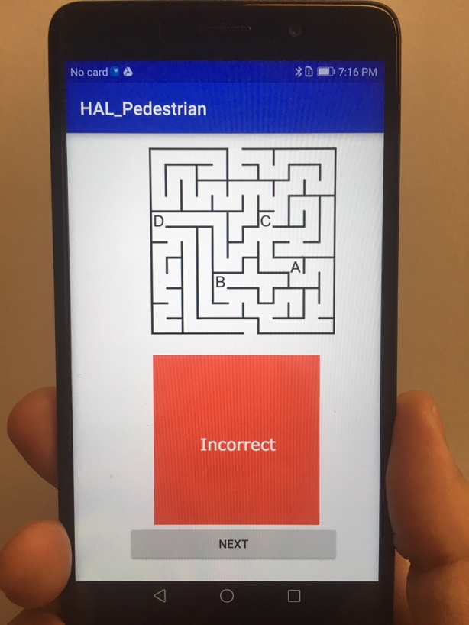
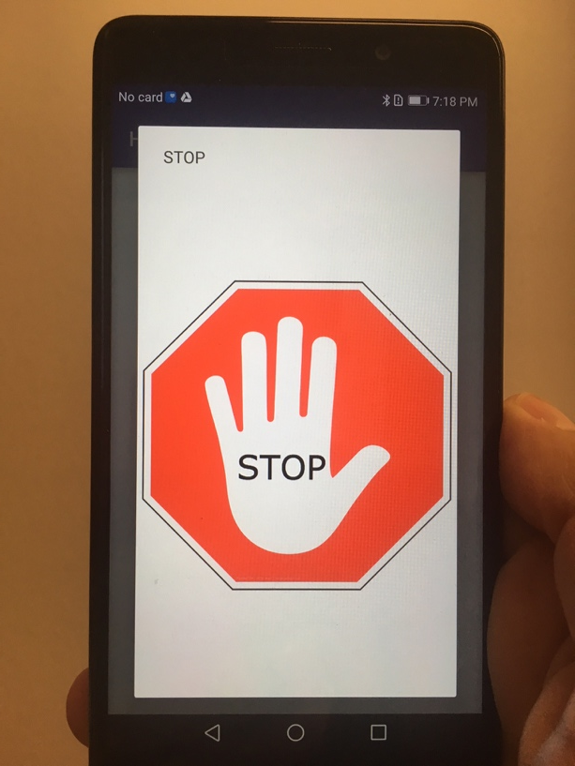
Apparatus (Current)
Participant solves a series of mazes
Progress interrupted by warnings
Requires Bluetooth connection to another Android device
Notes:
Series of 12x12 mazes
Data tracked automatically
Vibrate, tone and visual
Dismissed by participant

Slide 10
Notes:
Cars travel at 25 mph
~6 seconds of warning

Slide 11
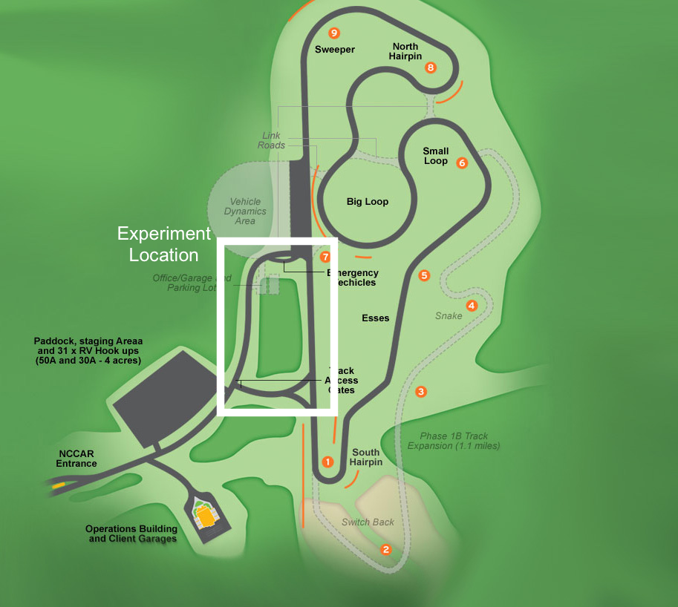
Experiment Setting
North Carolina Center for Automotive Research (NCCAR)
Notes:
North Carolina Center for Automotive Research (NCCAR) in Garysburg, North Carolina.
620-acre closed and controlled research and test facility that features a two-mile road course.
Recruit from local community. Healthy adults, no mobility impairments.

Slide 12
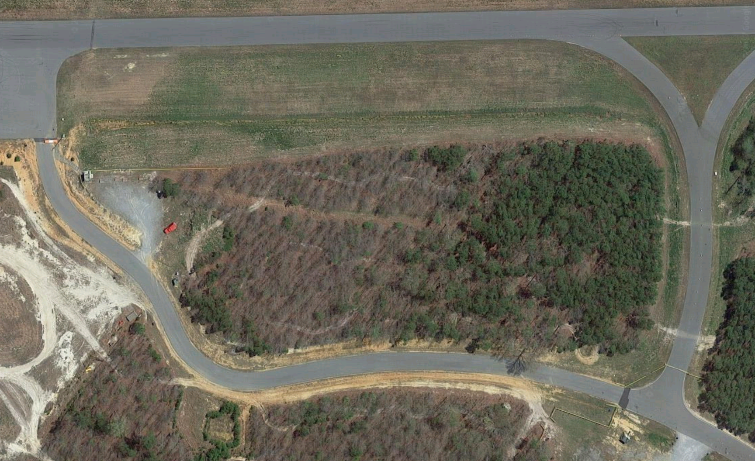
Control
Mark
“Late”
Mark
1
P
Car 2
2
Car 1
Notes:
Participant (P) stands on a marked spot off to the side of the road.
Experimenter (1) will stand near the participant, positioned so as to be able to see the participant, the roadway and the oncoming vehicles simultaneously. Experimenter 1 will monitor the roadway and provide instructions to the participant.
Second experimenter (2) will be stationed to see the start position where the cars will begin their routes and E1. Experimenter 2 will tell the cars when to start driving.
Experimenters on the ground will be in constant radio contact during experiment trials. The drivers will also have radios to listen to conversations between the experimenters and to receive notifications, if needed.
The roadway will be closed to outside traffic during the experiment, and participants will complete the experiment one at a time.

Slide 13
Notes:
First car will begin driving clockwise at 25mph toward the pedestrian’s location
Pedestrian instructed to begin solving a maze on the mobile device… while walking.

Slide 14
Notes:
When the first car is a predetermined distance from the pedestrian E1 will trigger the notification, which will interrupt the maze task.
The pedestrians may choose continue walking or stop.

Slide 15
Notes:
Repeat 30 times
100, 90 or 80% reliable
Based on on time, early, late

Slide 16
Experiment Protocol
Orientation
Informed consent & task overview
Demographic questionnaire
NEO-FFI
Training
Protocol review
3 practice trials (on site)
Data Collection
30 trials
~20 minutes
Post Experiment Interview
Trust questionnaire
Usability questionnaire
Debrief
Notes:
DVs: Response time, correct/incorrect choices (stop/didn’t stop)
App is recording all inputs w/ timestamps.
Usability is to establish a benchmark
Include elements of the previous study… part of a bigger combined dataset.

Slide 17
Next Steps
Finalize experiment script
Prepare materials
Train project team (April)
Run pilot test(s) (April)
Recruit participants & collect data (May/June)

Slide 19
Postscript
Year 2 Project: Machine Learning Tools for Informing Transportation Technology Design
Objectives:
Identify and acquire publicly-available sources of crash data suitable for machine learning analysis
Develop machine learning algorithms for historical crash data
Identify combinations of variables in data that influence crashes
Compile a list of design recommendations informed by the machine learning algorithms
Currently processing 1st draft of HSIS data
Suggestions?

Slide 20
Questions?
Michael Clamann
michael.clamann@duke.edu
http://hal.pratt.duke.edu

