Slide 1
Automation and safe systems
Louis A. Merlin, AICP, PhD
June 27, 2018

Slide 2
Connected vs. automated
Automated = vehicle that drives on its own
Connected = vehicle that communicates with other vehicles and infrastructure in real time
(Autonomous = vehicle that drives without communication)

Slide 4
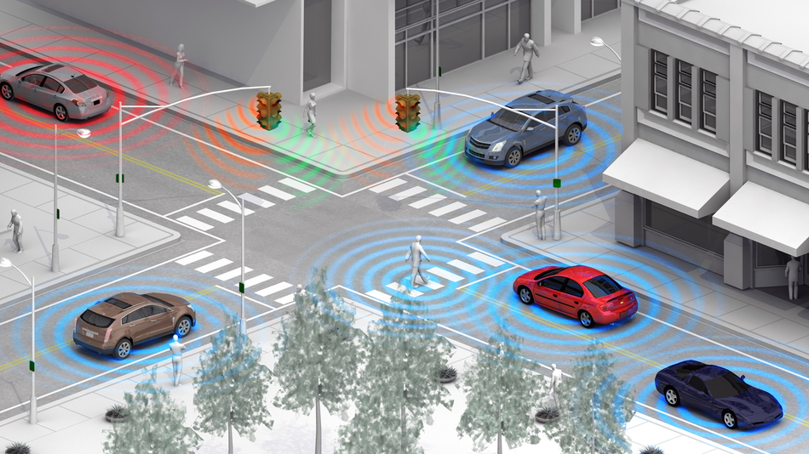
Connection: V2V, V2I, V2X
Source: Florida Department of Transportation
Notes:
BENEFITS
CONGESTION – PLATOONING, CRUISING THROUGH GREEN LIGHTS
SAFETY – SEE AROUND CORNERS

Slide 5
connectivity
V2V = Vehicle to vehicle
V2I = Vehicle to infrastructure
V2X = Vehicle to other devices, smartphones, etc.

Slide 6
Basic safety message
Vehicle size
Position
Speed
Heading
Acceleration
Brake system status
Transmitted 10x per second

Slide 7
SAE J3016 – Levels of Automation for Road vehicles
Level of Automation | Example Technology | Primary Responsible Driver
0 – No Automation | Regular cars | Human
1 – Driver Assistance | Cruise control | Human
2 – Partial Automation | Adaptive cruise control with lane keeping | Human
3 – Conditional Automation | Full highway automation | System with human backup
4 – High Automation | Full automation in many conditions, but not all | System, potentially with human backup
5 – Full Automation | Full automation from origin to destination | System
Notes:
We have long has level 1 automation.
Level 2 automation increasingly in the market and increasingly viewed as acceptable.
Big leap to level 3 and even bigger leap to level 4.
Many people believe that these technologies will be accepted gradually over time as they prove themselves in real world driving conditions.

Slide 9
Governance and Adaptive Regulation of Transformational Technologies in Transportation (T3)

Slide 10

T3 Course Overview
Through Duke Bass Connections
  Engage faculty, undergraduate students, graduate/professional students and trainees in teamwork
  Integrate disciplinary approaches and professional practice
  Apply knowledge, research and skills in problem-solving, with engagement from community partners
Energy & Environment theme
12 students, 3 faculty
2 projects,
Governing Autonomous Vehicles
  Policy Considerations for
  North Carolina
  North Carolina & Beyond

Slide 11
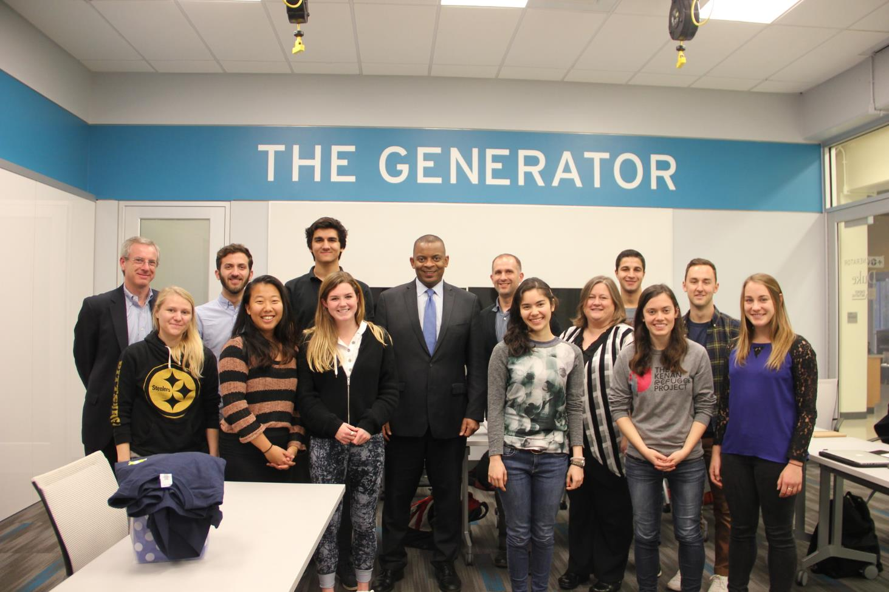

Slide 12
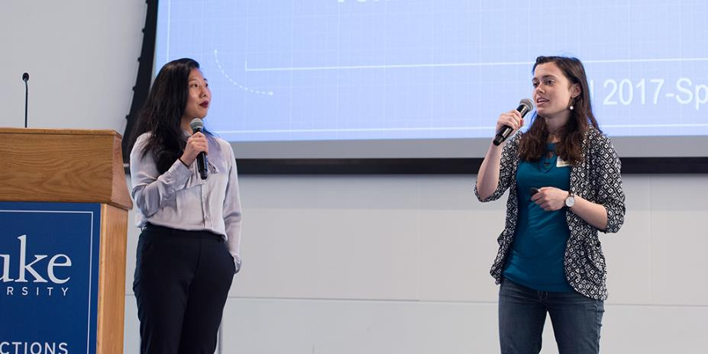

Bass Connections Showcase (April 2018)

Slide 13
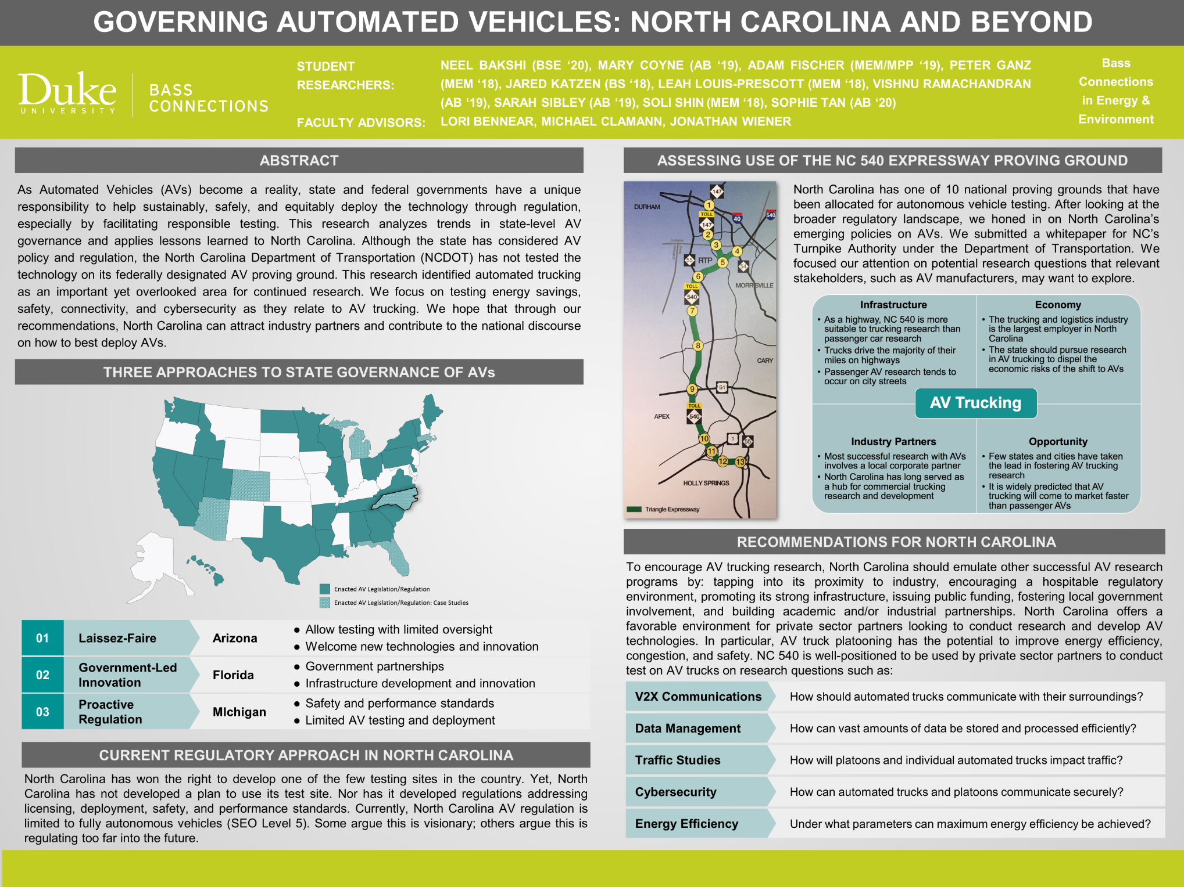

Slide 14
The National Automated Highway System Consortium
A Historical Perspective: Challenges and Legacy

Slide 15
Why look at the NAHSC
The scope of the project was very broad. It took a systems approach to the development of connected & automated vehicles before people were thinking about CAVs in this way.
It is a part of a long history of CAV research in the US.
Many of the technical, behavioral, social, and political issues that the Consortium researched and discussed are still important.
Participants from the NAHSC are now thought leaders and key researchers currently working the field.

Slide 16
Challenges
Technical Challenges
Object detection, longitudinal and lateral control, transitions between levels of automation
Deployment
Dedicated Lanes vs. Mix Traffic
Societal Issues
Institutional Issues
Public Acceptance, Public Participation and Promotion
How safe is safe
NAHSC Organizational Challenges
VMT, Land Use, Equity
“Nationwide compatibility” with “local tailoring”
Funding (development, infrastructure)
All decisions were made by consensus
Human Factors (in-the-loop, proper use, education)
Transit, Commercial, or Personal
Liability
Connected?

Slide 17
Six Major Milestones
Milestone #1
Establish Performance and Design Objectives
Milestone #2
Proof of Technical Feasibility (1997 Demo)
Milestone #3
Identification and Description of Feasible AHS Concepts
Milestone #4
Milestone #5
Milestone #6
Selection of Preferred AHS Configuration
Completion of Prototype Testing
Completion of System and Supporting Documentation

Slide 18
Each Milestone Addressed Three Themes
Technical Problems
Societal Concerns
AHS Institutional Considerations

Slide 19
Supplemental Information
For those who are interested, the following are slides about the participation and structure of the National Automated Highway Consortium (NAHSC)

Slide 20
NAHSC Participation
Core Participants
Associate Participants
Outreach Participants
Contractors
Government (U.S. DOT, Caltrans)
Industry (GM, Parsons Brinckerhoff, Bechtel)
Academia (PATH, Carnegie Mellon)
60 Associate Participants
AHS Stakeholder categories

Slide 21
NAHSC Timeline
1994
1995
1996
1997
U.S. DOT selects the National Automated Highway System Consortium (NAHSC) to implement Automated Highway System (AHS) research.
November - System Objectives and Characteristics Document finalized and published
August -Third Stakeholder Workshop
Demonstration in San Diego, California (aka Demo 97)
October - Second Stakeholder Workshop
April - First Stakeholder Workshop

Slide 22
Consortium Structure
Program Office
Overall management of the program
Program Managers Council (PMC)
Membership were the core participants program managers
Program Management Oversight Committee (PMOC)
Met bi-monthly
Membership consisted of associate and outreach participants
Provided support to program office
Policy Steering Board (PSB)
Met Semi-Annually
Set broad policy and goals for program
Met monthly

Slide 23
AVs and planning for road safety
1. Pedestrian safety through AV operations*
2. Safety & mobility through AV-driven planning
*Paper in press at American Journal of Preventive Medicine (Combs, Sandt, Clamann, McDonald)

Slide 24
1. Automated Vehicles and Pedestrian Safety: Exploring the Promise and Limits of Pedestrian Detection
FARS 2015 pedestrian fatalities vs. 2017 state-of-the-art pedestrian detectors
Research question: How many pedestrian fatalities could have been avoided if vehicles were replaced with hypothetical fully-automated ones equipped with present-day detection capability?
Assumptions:
  Vehicle programming is near perfect
  Laws/norms don’t evolve
  All pedestrian fatalities are theoretically avoidable
    Detection occurs far enough in advance
    Appropriate evasive action is always an option

Slide 25


Present-day pedestrian sensors
Visible light cameras
LiDAR
Radar
 | Sensor Type
Crash condition | Visible light camera | LiDAR | Radar
Dark/ low-light
Fog/ precip.
Reflective surfaces
Close-range pedestrian
Stationary pedestrian

Slide 27
Conclusions
Spatial mismatch
Technology choice
Spatial mismatch
Complementary approaches are critical!

Slide 28
2. Safety & Mobility through AV-driven planning
Basic premise:
  We know AVs won’t be a safety silver bullet; complementary approaches to safety will be critical
  AVs will completely change the policy landscape around mobility, accessibility, and safety
Objective: identify/describe planning theory approaches to better equip planning field to take policy leadership role

Slide 29
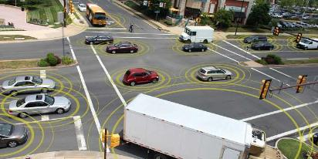
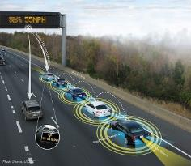
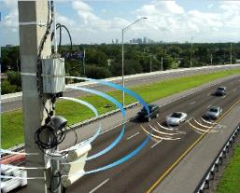
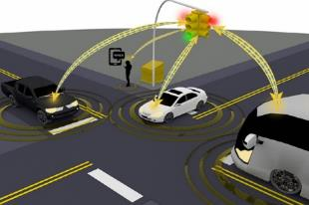
Connected and Autonomous Vehicles related activities at UTK
(Surface Transportation)
Capabilities and Differentiators
2018

Slide 30
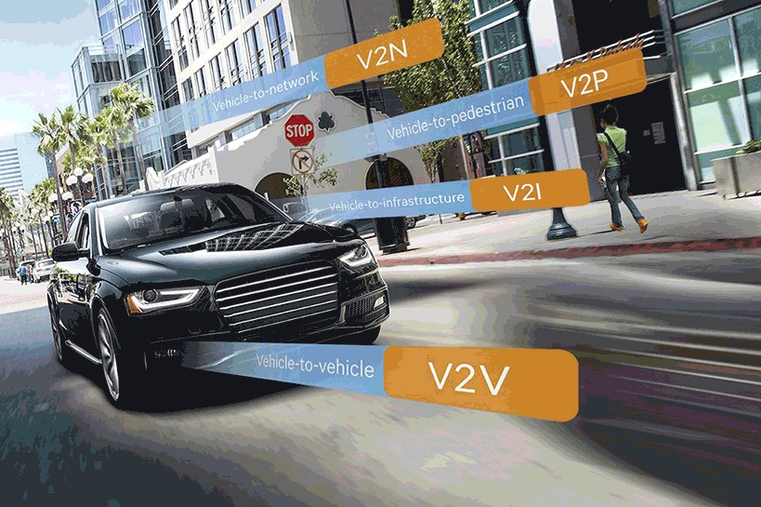
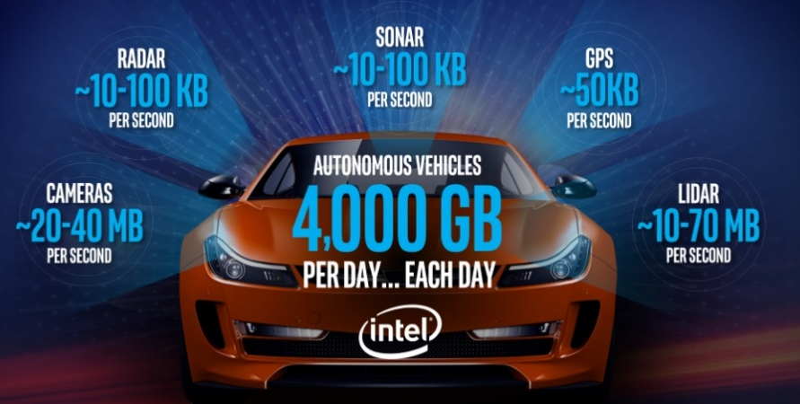
Capabilities
Research, Development & Deployment
  UTK real/virtual testbeds & vehicle simulators
  Instrumented & connected vehicles
  Capable research staff
Using big data to enable autonomy
  Communication/automated vehicle equipment
  Traffic signals lab
Safe, sustainable and intelligent mobility
  EcoCar development, controls, calibration
Industry-University-ORNL partnerships
Partners & $: DOTs, DOE, NSF, …
sites.ieee.org

Slide 31

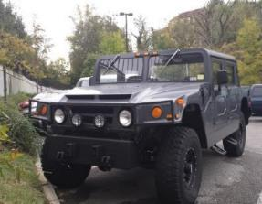
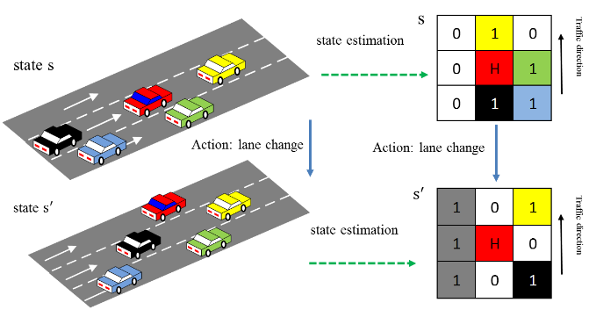


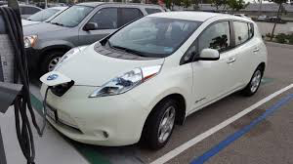
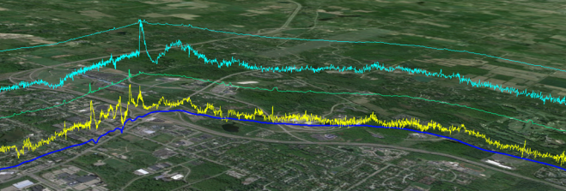
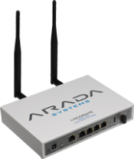
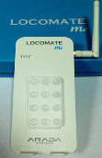
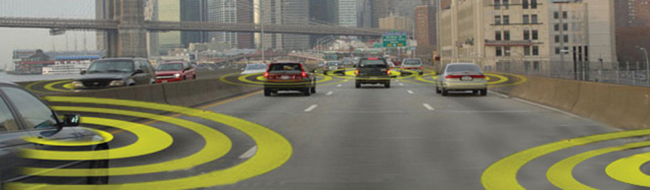


How volatile is y/our driving?
UTK instrumented vehicles have high-performance cameras, lasers, GPS Units, & DSRC devices.
Data collected from vehicle, infrastructure, & driver to test & develop algorithms in connected & automated vehicle environment
Battery Use
Driving Volatility
Differentiator-Concept & tools needed to reduce “driving volatility” & hence improve safety & mobility

Slide 32
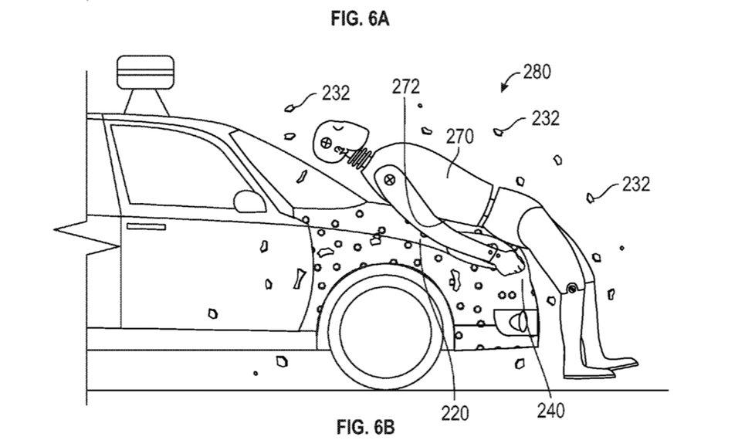
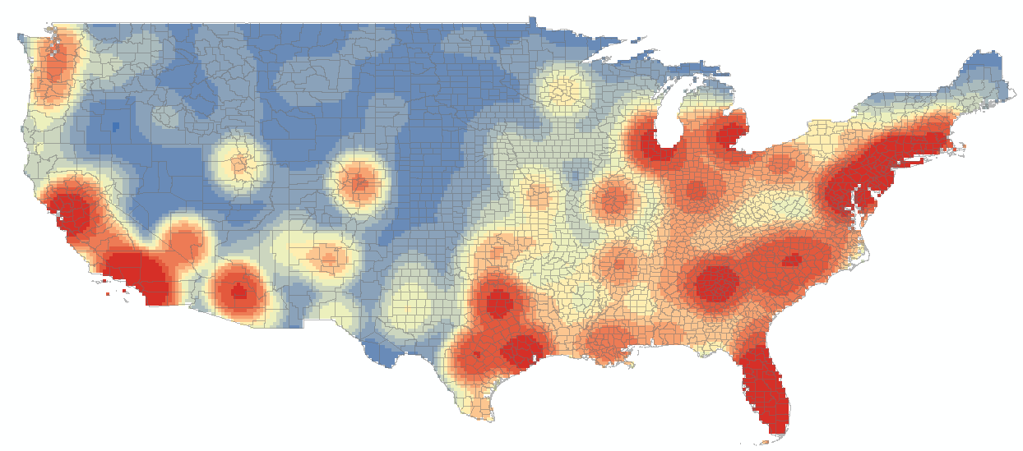
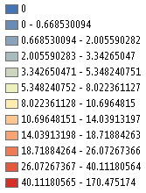
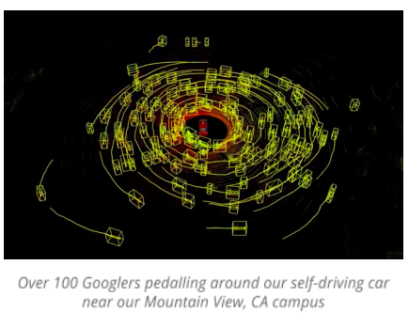
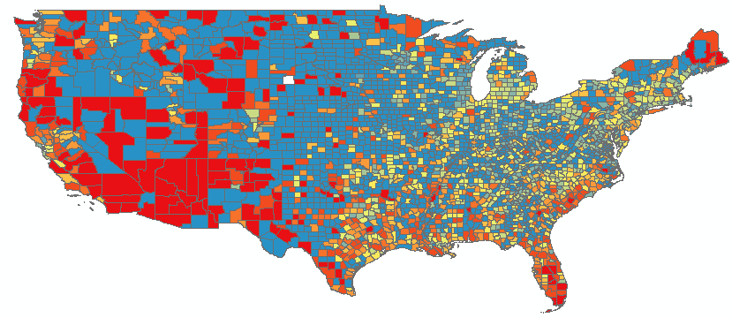
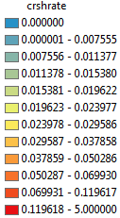


How will CAVs & vulnerable road users interact?
Pedestrian involved fatal crash distribution across US, 2013-2015
Three Key Pre-Crash Behaviors (FARS)
Dart-out/Dash
Dark clothing/Not visible
Improperly present at roadway
- Standing, Working, Lying, Playing
Crash rate (crash count / pop density)

Slide 33
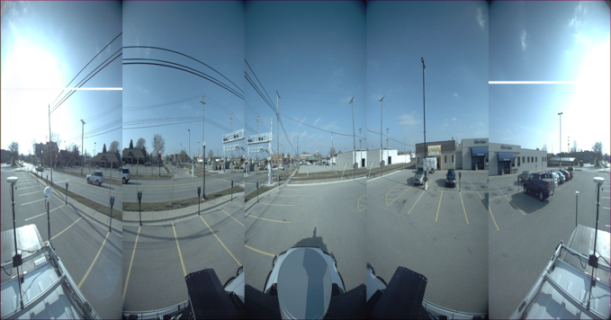
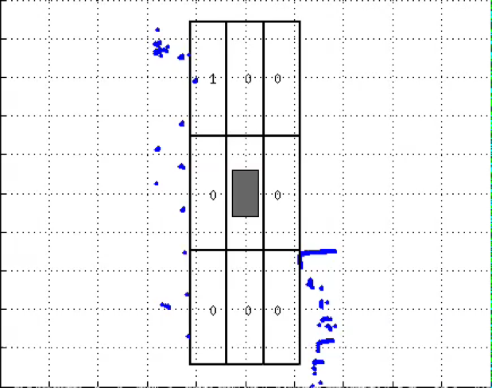
Solving practical problems
Core Research Areas
Deep learning-Learning driver behavior
Large-scale data processing (big data)
Decentralized multi-agent response optimization
Algorithms
Connectivity
Notes:
Virtual Reality platform
Immersive Environment –
Realistic vehicle physics, slick roads, poor visibility
Scalability, low cost, portability
Can emulate mix of CAVs and HDVs – Platform for testing coordination algorithms
Data impossible to find elsewhere

Slide 34
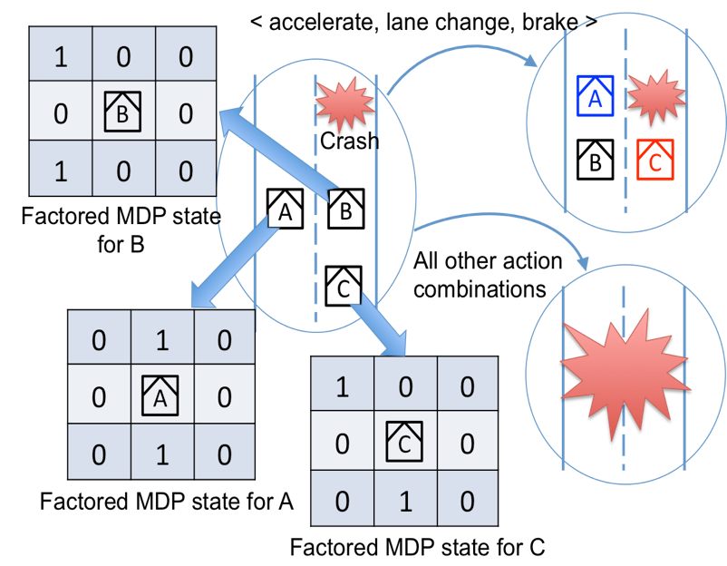
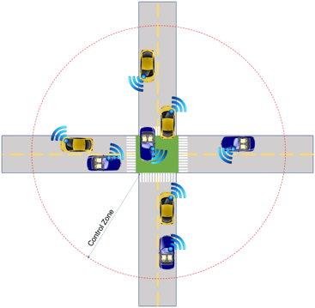
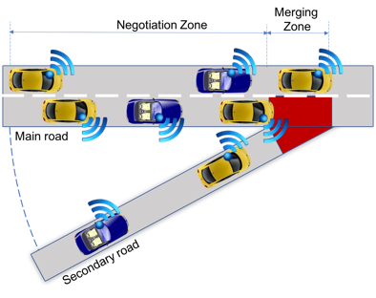
MDP Framework
Field Experimentation
Research, Development & Deployment

Slide 35
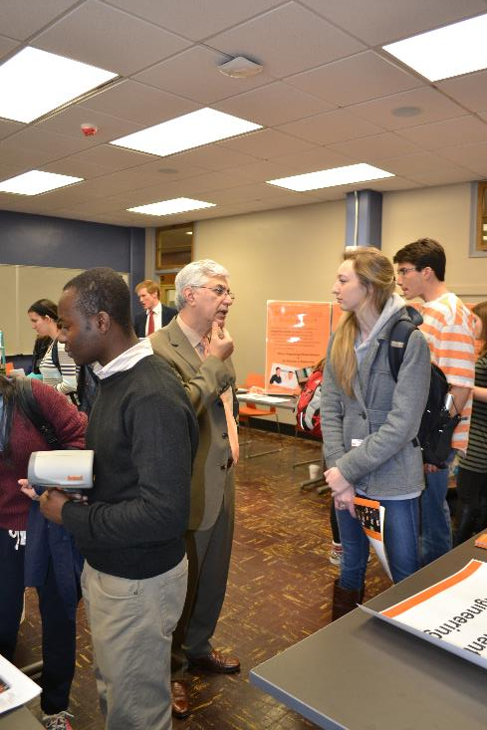
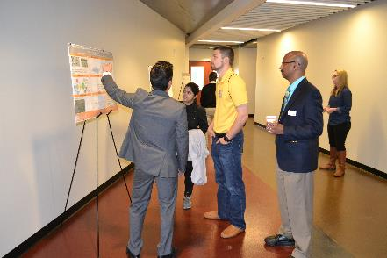
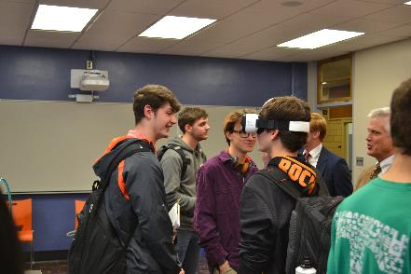
Outreach and Educational Activities
Accident reconstruction camp for 8th graders-CSCRS sponsored
K-12 STEM Education to develop and lead a "Summer Transportation Academy for Teachers (STAT)"
Mentoring high school students in a 4-week long summer program
Speaker Series Webinars with a focus on CAVs

